Slide 1
How our Identities and Values Affect our Proficiency in Dispute Resolution
IACP FORUM 2018
Nancy Cameron, Q.C.

Slide 2
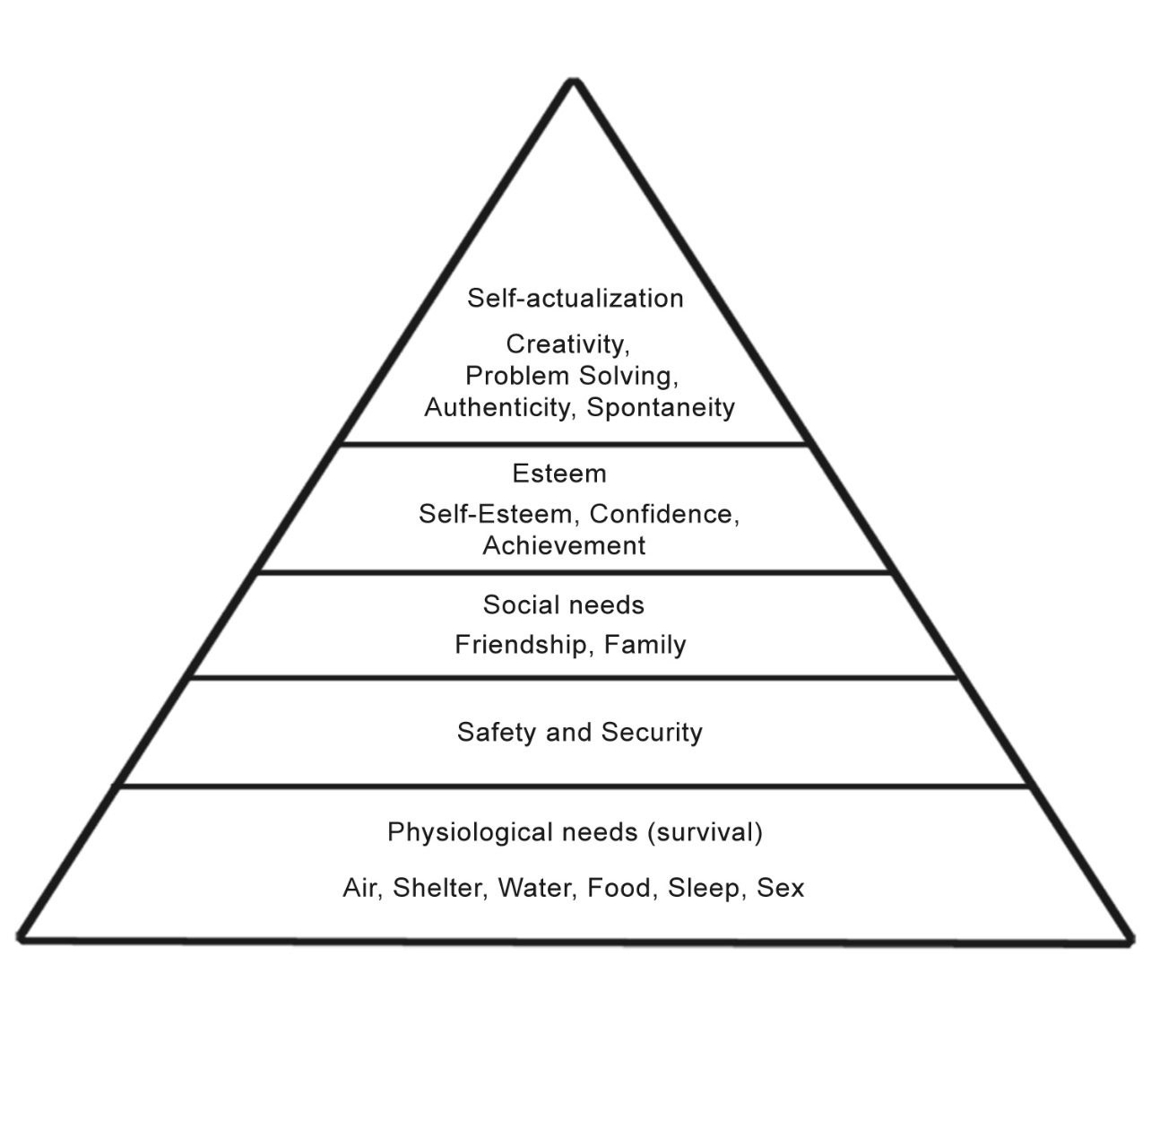
Maslow’s Hierarchy of Needs

Slide 3
The struggle to satisfy non-material human needs is the prime source of conflict. John Burton
Burton’s non-material human needs (Basic Human Needs Theory)
  Identity
  Recognition
  Security
  Personal Development

Slide 4
Importance of identity
Fundamental in protecting a sense of self
Fundamental in protecting group survival
Lodges in the narrative of how people see themselves
  Who they are
  Where they came from
  What they fear they will become or lose
  How they find and build meaning in life

Slide 5

Tribal Identity

Slide 6
Cognitive Biases and Tribal Identity
In troubled times and in times of conflict, there is a tendency to turn inward and say, “At least we understand our own people.”
Status quo bias
Certainty Bias
Brain is a pattern-seeking organ

Slide 7
Values Support our Identity
Values are connected to the way we understand the world
Schwartz: 10 distinct types of values defined by underlying motivations
  Some conflict, some are congruent
Apply across cultures
Research across 82 countries
Individuals and groups have different value hierarchies and priorities

Slide 8
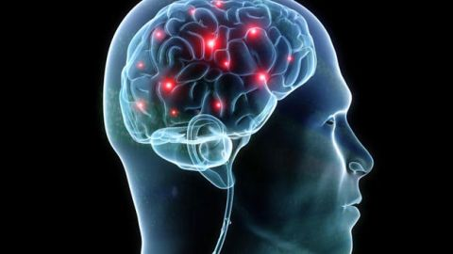
Values underpin beliefs and are linked to affect
When values are activated, they become infused with feeling
  Independence (Self-direction)
  Tradition
  Security
  Power

Slide 9
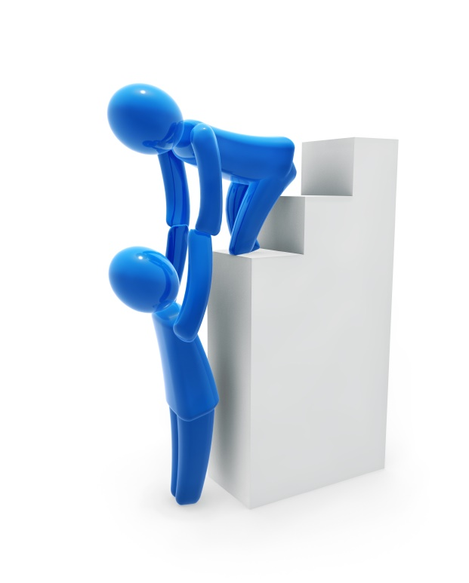
We choose actions because of our values
V
Value
F
Feeling
A
Action

Slide 10
Values Transcend Specific Actions and Situations
This distinguishes values from norms and attitudes

Slide 11
Values are ordered by importance
Generally, we upgrade or increase the importance we attribute to values that are readily obtainable and downgrade the importance of values when our pursuit of these values are blocked
BUT the reverse is true for power and security
  If these are blocked or thwarted, we increase the importance of these.

Slide 12
Universal values because they are grounded in, and help us cope with one or more of three universal requirements
1. Needs of individuals as biological organisms
3. Survival and welfare needs of groups
2. Requisites of coordinated social action

Slide 13
Self-Direction
Defining Goals: independent thought and action, choice, creating, exploring, freedom, choosing own goals, curiosity, independence, privacy
Meets 1 and 3 of universal requirements
1. Needs of individuals as biological organisms
3. Survival and welfare needs of groups
2. Requisites of coordinated social action

Slide 14
Stimulation
Defining goals: excitement, novelty, challenge in life, a varied life, an exciting life, daring
Meets #1 of universal requirements
1. Needs of individuals as biological organisms
3. Survival and welfare needs of groups
2. Requisites of coordinated social action

Slide 15
Hedonism
Defining goal: Pleasurable or sensuous gratification for one’s self , enjoying life, self-indulgent
Meets #1 of universal requirements
1. Needs of individuals as biological organisms
3. Survival and welfare needs of groups
2. Requisites of coordinated social action

Slide 16
Achievement
Defining goal: Personal success through demonstrating competence according to social standards and in terms of prevailing cultural standards, thereby obtaining social approval. Ambitious, successful, capable, influential, social recognition
Meets #1, 2 and 3 of universal requirements
1. Needs of individuals as biological organisms
3. Survival and welfare needs of groups
2. Requisites of coordinated social action

Slide 17
Power
Defining goal: social status and prestige, control of dominance over people and resources, authority, wealth. Emphasize the attainment or preservation of a dominant position within the more general society
Meets #2 and 3 of universal requirements
1. Needs of individuals as biological organisms
3. Survival and welfare needs of groups
2. Requisites of coordinated social action

Slide 18
Security
Defining goal: safety, harmony and stability of society, of relationships, and of self. Can include social order, family security, national security
Meets #1, 2 and 3 of universal requirements
1. Needs of individuals as biological organisms
3. Survival and welfare needs of groups
2. Requisites of coordinated social action

Slide 19
Conformity
Defining goal: restraint of actions, inclinations, and impulses likely to upset or harm others and violate social expectations or norms. Obedience, self-discipline, honoring parents and elders. Responsive to current, possibly changing expectations. Promote cooperation in order to avoid negative outcomes for self
Meets # 2 and 3 of universal requirements
1. Needs of individuals as biological organisms
3. Survival and welfare needs of groups
2. Requisites of coordinated social action

Slide 20
Tradition
Defining goal: respect, commitment, acceptance of the customs and ideas that one’s culture or religion provides. Close to conformity motivationally, but conformity entails subordination to persons with whom one frequently interacts, whereas traditions entails subordination to more abstract objects. Responsive to immutable expectations from the past.
Meets #2 and 3 of universal requirements
1. Needs of individuals as biological organisms
3. Survival and welfare needs of groups
2. Requisites of coordinated social action

Slide 21
Benevolence
Defining goal: Preserving and enhancing the welfare of those with whom one is in frequent personal contact (the “in group”) particularly family and other primary groups. Helpful, honest, forgiving, responsible, loyal, true friendship, mature love. Internalized motivational base for cooperation and supportive social relationships
Meets # 1 and 2 of universal requirements
1. Needs of individuals as biological organisms
3. Survival and welfare needs of groups
2. Requisites of coordinated social action

Slide 22
Universalism
Defining goal: Understanding, appreciation, tolerance, and protection of the welfare of all people and for nature. (Contrasts with in- group focus of benevolence values). Combines two sub-types of concerns: for the welfare of those in the larger society and world, and for nature.
Meets #1 and 3 of universal requirements
1. Needs of individuals as biological organisms
3. Survival and welfare needs of groups
2. Requisites of coordinated social action

Slide 23
Prioritizing my Values
Schwartz Basic Universal Values
Prioritize yours
Pair and share
Group debrief

Slide 24
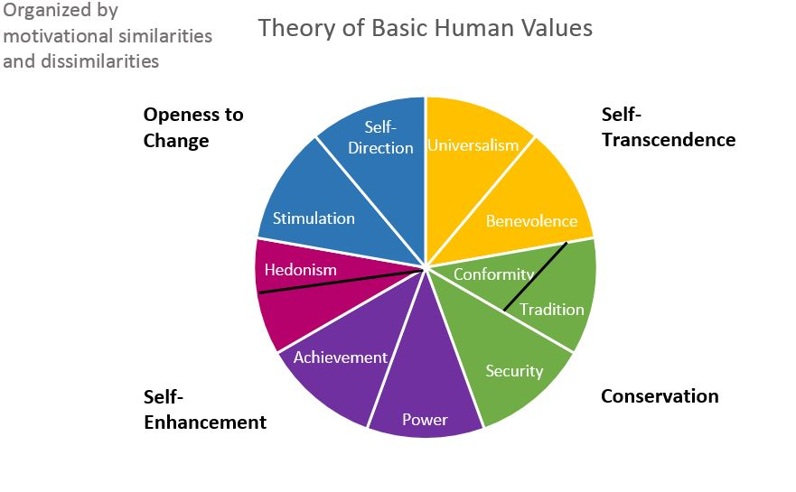
Schwartz

Slide 25
The circumplex
The values form a continuum of related motivations
The closer two values are in either direction on the circumplex, the more similar the underlying motivations
The further apart, the more antagonistic the underlying motivations

Slide 26
Motivational Emphasis of
Adjacent Values
Power and achievement – social superiority and esteem
Achievement and hedonism – self-centred satisfaction
Hedonism and stimulation – a desire for affectively pleasant arousal
Stimulation and self-direction – intrinsic interest in novelty and mastery
Self-direction and universalism – reliance upon one’s own judgement and comfort with the diversity of existence
Universalism and benevolence – enhancement of others and transcendence of self-interests
Benevolence and tradition – devotion to one’s in-group
Benevolence and conformity – normative behaviour that promotes close relationships
Conformity and tradition – subordination of self in favour of socially imposed expectations
Tradition and security – preserving existing social arrangements that give certainty to life
Conformity and security – protection of order and harmony in relationships
Security and power – avoiding or overcoming threats by controlling relationships and resources

Slide 27
Intrinsic Goals and Values – Extrinsic Goals and Self-enhancement Values
Intrinsic goals and Intrinsic values
Includes: values of self-acceptance, broadmindedness, affiliation, community feeling and social justice
Extrinsic goals and Self enhancement values
Include: conformity, image, social recognition, popularity, preservation of public image, wealth, financial success and authority

Slide 28
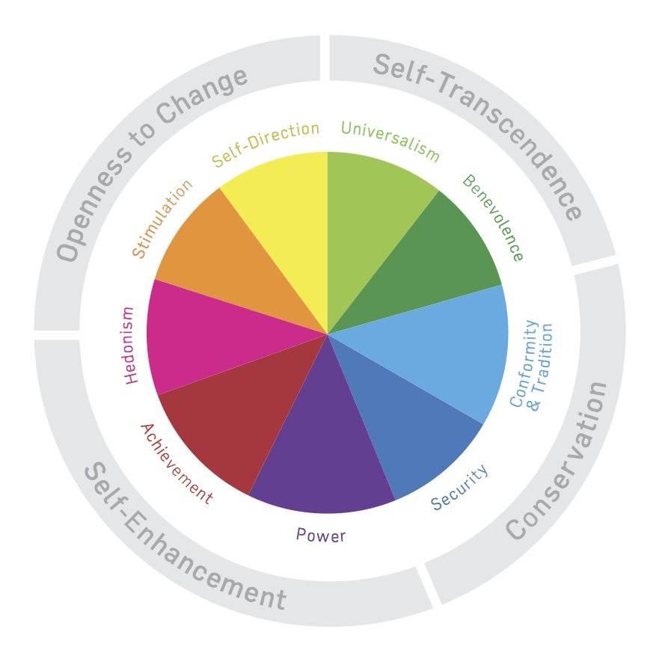
Priming for values – engaging values can suppress opposing values

Slide 29
If Power and Security are blocked, these values become more important.

Slide 30
Form our circumplex

Slide 31
Reflective Exercise
Think of a value-based conflict you have had. It can be personal or professional. What happened? What were the underlying values on each side? Are there things that you would do differently now that you understand the opposing values and the underlying motivations?
Reflective, then pair and share.

Slide 32
High and low self Monitoring
Mark Snyder

Slide 33
High and Low Self Monitors
High Self Monitors
Low Self Monitors
Concerned about how others see them
Behave so as to reflect the norms and expectations of the situation they enter
Pragmatic
Like to know the situation they are entering before hand, so can govern their actions accordingly
When asked to list personal attributes, tend to report more publically visible or available aspects
Less concerned about how others view them
Guided in their behaviour by their own traits and values rather than situational expectations
When asked to list personal attributes, tend to report internal attributes, values, enduring preferences, etc.

Slide 34
High Self Monitors
Low Self Monitors
Would self-describe as “socially appropriate” (and describe LSMs as not socially adept)
Can be supple, an agility that increases success, up-manage
May have a reputation for being all things to all people
May describe HSMs as fake
Consistency and commitment can lead to enduring relationships
May show more commitment to an organization they have committed to, less likely to craft images conducive to advancement within the organization

Slide 35
Are you a high or a low self monitor?
Read through the questions on the self test. Circle T (true) or F (false) as it applies (or not) to you.
To score, looking at your test sheet, circle each number where your answer IS THE SAME as the answer on the score sheet. For example, if you answered F for question #1, then circle #1 on the score sheet. If you answered T for question #1, do not circle #1.

Slide 36
Implications for high and low
self monitoring styles in team work,
and between professionals and
their own clients

Slide 37
Tom and Mandy Exercise One
The agenda for the team meeting:
Have a thorough discussion about Mandy and Tom’s underlying values and the corresponding motivations for each of them. Figure out how you can check your assumptions about their values. Think about how you might get triggered by Mandy or Tom. Develop next steps or strategies to help move forward.

Slide 38
Tom and Mandy Exercise 2: You have set a team meeting. Decide how to structure the team meeting, both in terms of process and content. Discuss how the team meeting will be structured, keeping in mind high and low self-monitoring, and the team’s respective values, and how you can leverage the values of the team members to support the clients.

Slide 39
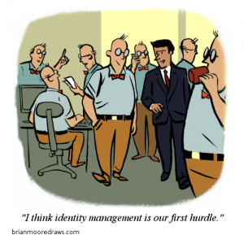

Slide 40
Identity
What functions does identity perform?
Why is it important in our work?

Slide 41
How does identity manifest?
Personal Core Identity
Group Identities
  Social
  Cultural
  Professional
Relational

Slide 42
Meaning-making and identity
Personal Core Identity seeks meaning in existence
Group Identities seeks meaning in co-existence
Relational identity constantly changing as you negotiate the relationship

Slide 43
Relational Identity
Two concrete dimensions – affiliation and autonomy
Keeping affiliation and autonomy in equilibrium is paramount to harmonious relationships.
Social rejection registers in the anterior cingular cortex, same portion of the brain that processes physical pain

Slide 44
Five pillars of Identity
Building on Dan Shapiro’s work
B Beliefs
R Rituals and Allegiances
A Appreciation and Recognition
V Values
E Emotionally charged experiences (both positive and negative), Taboos

Slide 45
List as many components of your Core Identity as you can think of in each of the areas.
Beliefs – convictions, principles, morals, can include beliefs about gender, race, ethnicity, moral underpinnings
Rituals and Allegiances –deep loyalties can be people, nation, tribe, ancestor, place, thing, real or mythical, rituals meaningful customs and ceremonial acts, likely related to your allegiances don’t have to be sacred rituals.
Appreciation and Recognition: How do you strive to be in the world? What would your one-line epitaph be? How do you strive to show up?
Values – look at what you prioritized in Schwartz’s values. Elaborate on these.
Emotionally charged experiences. Think about taboos. About how you have created your own narrative of what is sacred to you. What is important for you to feel secure? How does your health or past trauma inform this?

Slide 46
Appreciation and recognition
Rituals and allegiances, loyalties
Positive emotionally charged experiences
BELIEFS
Values
Taboos
Negatively charged emotional experiences

Slide 47
Mapping your Core Identity
Don’t worry about putting things in the wrong circle.
  Mapping off the circles is ok
Don’t be afraid to do stream of consciousness.
Go as deep as you want, you will have a chance to share, but only want you want to share

Slide 48
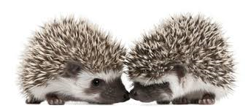
Pair and share – two things that surprised you.

Slide 49
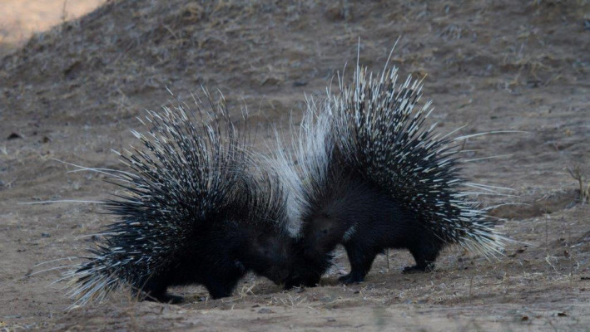
Think of an emotionally intense conflict where you felt attacked
Unpack how your core identity was being threatened, and what was happening for you in your relational identity.

Slide 50
Think of an emotionally intense conflict.
CORE IDENTITY
How was my core identity threatened?
Beliefs felt attacked?
Rituals felt endangered, Allegiances felt strained.
Appreciation: What of importance to me, in how I strive to show up in the world, felt de-legitimitized?
Values felt threatened?
Emotionally meaningful experiences or memories felt de-legitimized?
RELATIONAL IDENTITY
In what ways did I feel…
Unappreciated for my perspectives or effort?
Constrained in autonomy to act or feel as I would like?
Disaffiliated: alienated or treated as an adversary?
Disrespected in status?
Cast in an offensive role?

Slide 51
Your Professional Identity
Do the pillars for your professional identity as a collaborative practitioner
Pair and share
Whole group

Slide 52
Some Components of Professional Identity
Principled
Purposeful
Caring
Pragmatic
Achiever, gets things done
Thoughtful
Loyal
Committed
Responsible
Dependable
Fun-loving
Spontaneous
Versatile
Self-confident
Decisive
Honest
Ethical
Respected
Community Leader
Good communicator
Good listener
Easy going
Mentor
Team Player
Agreeable
Generous
Patient
Charismatic
Intelligent
Knowledgeable
Professionally skilled
Skilled advocate
Fair
Detail oriented
Thorough
Kind
Even-tempered
Inclusive
Creative
Compassionate
Tolerant
Able to support my opinions
Gracious
Professionally respected
Empathetic
Good story teller
Friendly
Skilled facilitator
Status
Prestige
Objective
Passionate

Slide 54
Triggers of Professional
Identity Conflicts
Differential treatment
Different values
Assimilation

Slide 55
Triggers of Social Identity Conflict
Differential Treatment – can create group polarization when different groups are treated differently
Different Values
Assimilation (majority group expecting others to act just like them)
Insult or humiliating action – comments or behaviours devaluing one group to another
Simple contact – when intergroup anxiety is high, simple contact can be polarizing and create conflict

Slide 56
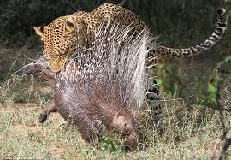
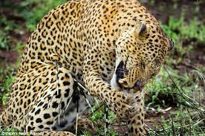
Oh no! Not another conflict!
Think of a professional conflict you have had. Look at the attack points – core and relational. What was happening for you? What do you think was happening for the other person?

Slide 57
Systemic Change
How do we encourage CDR Models?

Slide 58
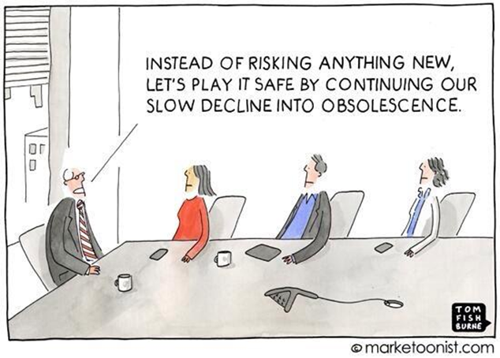

Slide 59
Values informing processes
Values underpinning judicial decision making and court processes
Values underpinning consensual dispute resolution

Slide 60
Something new from today
Where to from here?

Slide 61
Thank You

