Slide 1
Understanding Conflict and How to Protect Children From Divorce Fallout
IACP( International Association of Collaborative Professionals) Forum
October 25-28 2018・Seattle Washington

Slide 2
Samar Shata, MCP, RCC Child & Family Therapist, Alyson Jones & Associates

Slide 3
Salley-Ann Ross, MACC, RCC, Child & Family Therapist AJA, West Vancouver, Canada

Slide 4
Ida Forsat, MCP (Candidate), Child and Family Therapist, AJA

Slide 5
Alyson Jones MA, RCC Clinical Director AJA

Slide 6
And What about you?
How many lawyers?
How many mental health professionals?
Mediators?
Judges?
How many of you have worked on high conflict cases?
How many practice exclusively collaborative?

Slide 7
Let’s get right into the bad news…

Slide 8
Children and Divorce
Children who have experienced a parental separation and divorce are at higher risk for:
Depression
Anxiety
Self-harming behaviors
Suicide
Academic issues
Promiscuity
Teenage pregnancy
Alcohol and drug misuse
Addictions
Problematic relationships
Divorce for themselves
Aggression & violence
Heart disease

Slide 9
We see this played out through Externalized issues:
Disobedience
Delinquency
Aggression
Anti Social Behaviours

Slide 10
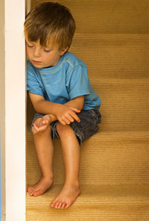
Internalized Issues
Depression and Self Harm
Anxiety
Lack of self-identity and personal boundaries
Eating Disorders
Increased somatic symptoms

Slide 11
Problems in Learning
The higher the conflict, the more academic problems
Lower cognitive and educational performance
Less engagement in school
Decreased attendance
Less respect for educational institutions
This applies to all the different
ages and stages

Slide 12
Why?
Stress associated with a divorce.
Parents are more distracted during a divorce and do not parent as effectively.
Moves and major changes that the children do not get an opportunity to process appropriately.
Diminished economic resources.
Children caught in a high conflict situation.

Slide 13
Non-Divorced
Divorced
The likelihood of negative outcomes for children of divorce is fifty percent higher.

Slide 14
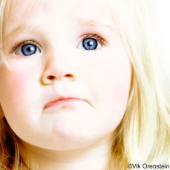

Slide 15
And now for the good news…

Slide 16
There is no denying that divorce does have an impact on children.
If the divorce is handled well, children can adjust and develop resiliency.
With appropriate responses, negative impacts can be mitigated.
It is within the power of the parents to decrease the statistical probability of these negative outcomes.
It is within the scope of the professionals working with transitioning families to reduce the negative outcomes of parental conflict.

Slide 17
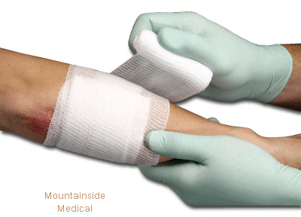
The Wound of Divorce
Divorce is a wound that needs to be tended properly.
With proper treatment and care a wound becomes a scar.
These scars become part of us and our character actually part of our interesting life story.
If the wound does not heal and continues to fester, it will become infected.
It is the toxic wounds that hinder our lives and can potentially be life-threatening.

Slide 18
Divorce Adjustment
Adjustment to divorce takes longer than expected and requires proper treatment.
It is very difficult for children to adjust when their parents do not adjust.
Parental behaviors during divorce have a great impact on future expectations in relationships of children regarding issues of closeness, trust, having children etc.

Slide 19
The vicious cycle
Poor parental behavior during divorce
Children’s expectations of relationships
Issues within their own parenting
Issues of closeness/trust as adults

Slide 20
The positive cycle
Cooperative parenting
Their own cooperative parenting
Children’s expectations of relationships
Closeness/trust as adults

Slide 21
Factors elevating risk creating High Conflict Divorces
Episodes of violence between parents, ongoing conflict and hostility between parents
Court actions by parents
Psychological maladjustment of parent
Sudden or frequent changes of residence and school, interruption of peer relationships
Disruption of parenting routine, loss of relationship with a parent
Economic hardship, loss of security and stability, negative family reinforcement
Notes:
Remember that families don’t breakdown spontaneously. Normally significant history of dysfunction during relationship leading to separation.

Slide 22
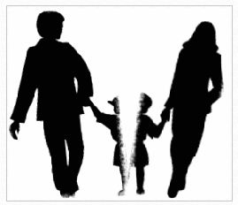
CONFLICT CHANGES CHILDREN

Slide 23
What is Conflict?
“An active disagreement between people with opposing opinions or principles”
(Cambridge dictionary)

Slide 24
A Few Facts about Conflict
Conflict is a reality in every family.
The people we are closest to evoke the biggest emotional reactions.
Not all conflict is “bad”.
Brief, moderate, and predictable conflict is not problematic, but rather this can actually prepare a child for the “real world”.
Our survival is dependent on our ability to deal with stress and manage conflict.
Each family has its own threshold as to when conflict becomes destructive.

Slide 25
The Real Story About Conflict
It is not the divorce itself that causes significant problems for children.
It is the level of conflict and the quality of parenting afterwards that determines the impact.

Slide 26
Parental conflict is the predictor of child maladjustment rather than divorce itself
(Kelly, 2000)

Slide 27
The important message is:
How conflict is managed, rather than if conflict occurs, will determine children’s adjustment and whether the conflict is destructive or not.

Slide 28
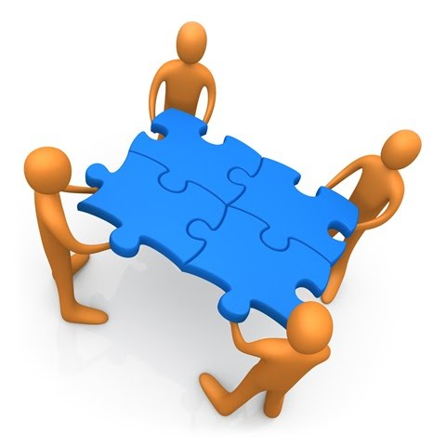
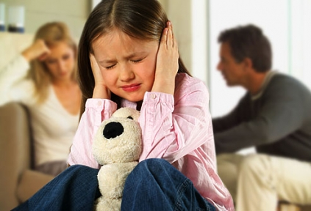
What Makes Conflict Destructive for Children?
Conflict is a part of life. It is the style of conflict that determines if it is destructive or constructive.

Slide 29
Conflict is Destructive When:
Highly hostile (physical or verbal).
The intensity of the conflict is high (stress significantly increases in children).
The frequency of the conflict is often, or occurs at unpredictable times (this leads to a prolonged fear reaction).
There is no resolution (this leads to feelings of insecurity).
There are no buffers for the children (this results in lack of protection from the conflict).

Slide 30
If the Conflict Centers on the Child, it is More Destructive to the Child
Custody and access issues
Differences in parenting styles and values
Children react to child-centered conflict by:
Self-blame
Shame
Withdrawal
Feelings of inadequacy
Feelings of responsibility
Fear

Slide 31
Conflict Can be Constructive
Can help us understand and appreciate differences
Resolved conflict builds empathy
Can lead to effective patterns of resolution
Can provide insight
Can aid us in anticipating and resolving future conflicts
Can bring us closer together as we isten, understand and validate each other
Can provide a source of information
Can increase unified parenting if conflict is managed well
Can decrease anxiety as constructive conflict helps us face issues instead of denying or avoiding them
Brings problems to light, and thus offers us the opportunity to brainstorm solutions and make progress.

Slide 32
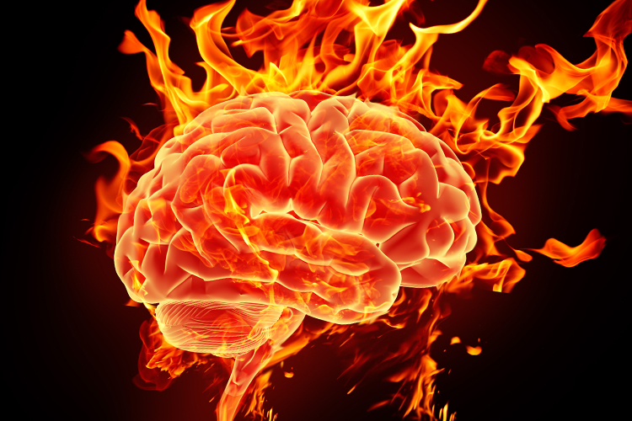
CONFLICT AFFECTS BRAIN DEVELOPMENT

Slide 33
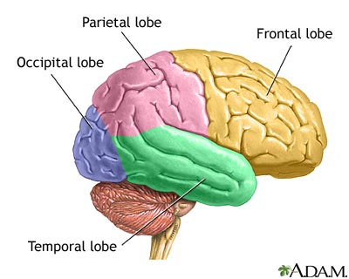
A Few Facts about Child and Brain Development
Brain development is more pronounced at various developmental stages.
During the first few years of life, there are high levels of brain development.
Brain cells develop their primary connections over the first 2 years and then they are sculpted throughout the rest of the lifespan.
Ages 5-6, the prefrontal cortex develops.
During adolescence, there is also a “growth spurt” in brain development.

Slide 34
Primary Factors for Healthy Brain Development
Safe environment
Nutrition
Exercise and activity
Health care
Secure attachments
Attention and attunement from the caregivers
Affection
Lack of injury
Stimulation of all 5 senses
Opportunities for daily learning
Repetition of stimuli

Slide 35
The Adolescent Brain
Yes, they do have one… and it is firing on all cylinders!
The “emotional brain” (limbic system) is often in charge.
The frontal cortex is going through great growth.
They need guidance for using their “thinking brain” (planning, organizing, problem solving, decision making).
If experiencing a HCD, parents often let go of the lead and this can impact the development of a teen’s higher functions.

Slide 36
Developmental Psychology and Brain Development
Healthy brain development results in:
An effective network of pathways
Appropriate movement through each developmental stage
Increased opportunities for potential and mastery

Slide 37
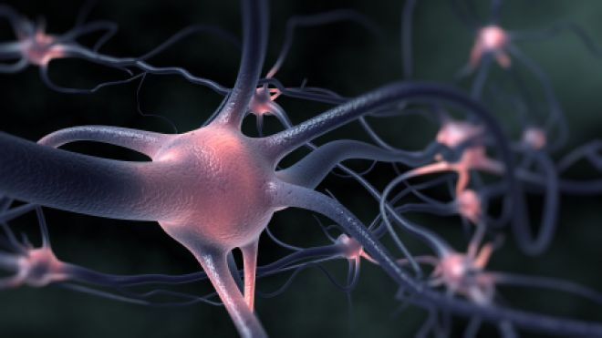
Epigenetics
Epigenetics – is the emerging science that explores how our brain development is impacted by genetics and environment.
Nature and nurture are not independent factors.
The environment in which the organism grows and develops will directly impact the genetic material of the organism.

Slide 38
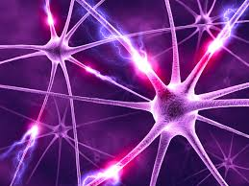
The brain is not just a product of genetics; it is a product of the environment in which it grows.
Our neuron pathways are formed by our experience and our environment.

Slide 39
Neurological Pathways Directly Affect:
The ability to process information
Language and the ability to express emotions and thoughts
Health and well being
Behaviors
Cognitive reasoning
Higher functioning

Slide 40
Children Experiencing HCD Become Wired to be:
Anxious
Agitated
Distractible
Highly aroused
Impulsive
Aggressive
Underdeveloped empathy and compassion

Slide 41
Acestoohigh.com
What are ACEs? (Adverse Childhood Experiences)
ACEs are adverse childhood experiences that harm children’s developing brains so profoundly that the effects show up decades later; they cause much of chronic disease, most mental illness, and are at the root of most violence.

Slide 42
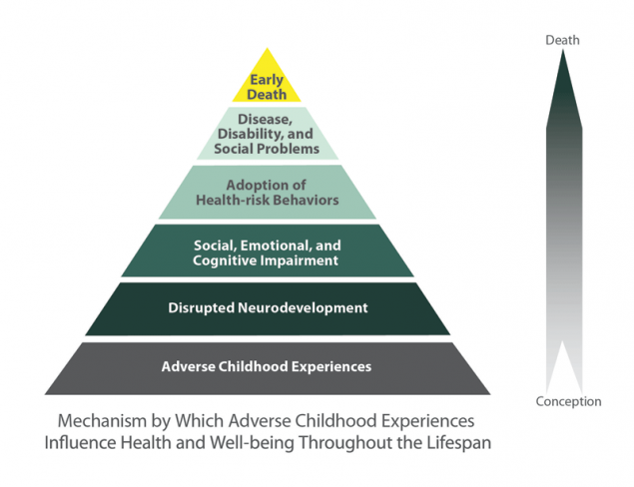
Center for Disease control and prevention – Aces study –acesstudy.com

Slide 43
What is Stress?
“A state of mental or emotional strain or tension resulting from adverse or very demanding circumstances.”
(Oxford Dictionary)

Slide 44
Stress and the Brain
Some stress is helpful as it can help protect us when there is danger, it can make us more alert, and it can assist us in accomplishing our goals.
When stress is chronic, it throws our balance off and sends confusing signals to our brain, thus affecting brain chemistry.
There are many hormones in action when we experience stress but Cortisol is our primary stress hormone.

Slide 45
Cortisol
Cortisol is released from our adrenal glands.
Simply put, the main function of cortisol is to restore balance in our system after a heightened experience.
Too much or too little cortisol becomes problematic (too much can cause cell death and attentional deficits, and too little can impair our ability to regulate and respond).
Our immune system becomes highly compromised when our cortisol is unbalanced and we are suffering from chronic stress.
A high conflict divorce (HCD) often results in chronic stress for children, during very important stages in brain development.

Slide 46
Chronic Stress Associated with a HCD is Destructive to Children Because:
A persistent fear response alters neurochemistry.
Hyper-arousal will alter the ongoing baseline for appropriate arousal.
It may result in dissociation (mentally and emotionally removing the self from the situation).
It disrupts attachments (the child becomes focused on ‘surviving’ rather than growing, maturity is impaired).

Slide 47
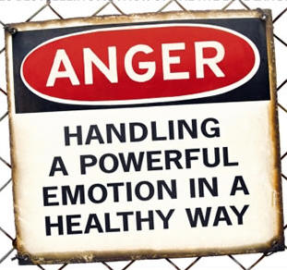
Managing HCD situations is important, as the associated stress impairs the immune system of youth, and high conflict impairs brain development.

Slide 48
Brain Potential
Brain growth and plasticity are directly affected by emotional interactions with our caregivers.
Many brain capacities were originally thought to be fixed at birth, but we are now discovering that they are actually dependent on a sequence of experiences combined with heredity.
The more brain cells are activated, the more potential.

Slide 49
The Brain & Memory
The more repetition, the stronger the memory (this can be both beneficial and harmful).
With HCD, the repetition of conflict can embed negative memories and disrupt healthy brain development.

Slide 50
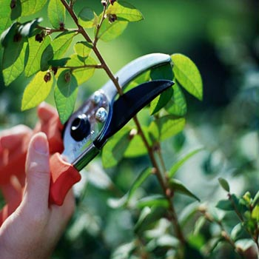
Pruning the Pathways
High conflict can disrupt the sensitive periods of brain growth in children and this can result in a disruption of potential. If certain synapses and pathways are not being activated, they may be discarded. This loss of pathways is often referred to as “pruning”. A developing brain’s capacity can be diminished by destructive conflict.

Slide 51
The younger the child of a HCD, the more difficult it is to reverse the negative impact on the brain development of children.
(Weinstein et al., 2000)

Slide 52
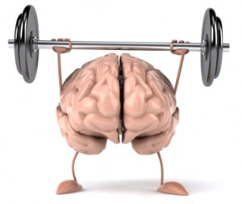
Thank Goodness for the Plastic Brain!
The brain is more “plastic” than we originally thought.
Plasticity is the brain’s ability to change in response to repeated stimulation.

Slide 53
A quick look at the research…

Slide 54
There is a direct link between parental conflict and the child’s cognitive and intellectual development. This link also applies to parental conflict and the child’s ability to regulate attention and the stress response.
(El-Sheikh, 2008)

Slide 55
Trauma is not limited to children witnessing violent conflict between their parents, but non-violent discordant conflict between parents also has significant effects on the brain development in children.
(Cummings & Dawes, 2010)

Slide 56
Children from divorced families are two times as likely to be prescribed medication for ADD/ADHD than children from intact families.
(University of Alberta Study)

Slide 57
Long Term Effects of High Conflict:
Changes in the nature of the child-parent relationship
Creates significant anxiety and distress
Impacts brain development and limits potential
Overstimulates and frightens children
Compromises identity development
Creates feelings of helplessness and hopelessness

Slide 58
HIGH CONFLICT AFFECTS ATTACHMENT

Slide 59
It all begins with Attachment
Attachment is a strong emotional connection, such as the bond between a child and caregiver
Attachment joins people together emotionally
In psychology, the concept of attachment helps explain development and personality
Essential for human survival and development; we need each other and we protect each other. Parent-child attachment is normal and needed
For the parent to protect and the child to be drawn to the protector is natural, and it is what has kept us alive and thriving
As Divorce Professionals it is best to do whatever we can to support the secure attachment to both parents.

Slide 60
Attachment wounds
Attachment issues can occur when there is an insecure attachment to the caregiver, or when the security of the attachment is undermined by the actions of another through alienating behaviours.

Slide 61
HCD can lead to Attachment Disruptions or Disorders
An Attachment Disruption occurs when the natural attachment between a child and caregiver is disrupted as a result of circumstances causing separation from a caregiver. Can be due to death, or to estrangement or alienation
An attachment disorder is a disorder of mood, behaviour and social relationships which results from a failure of the child to form a normal attachment (bonding) with their primary caregiver(s).
These issues can result when parents are highly distracted, negligent, aggressive or engaged in alienating behaviours.

Slide 62
Parental Alienation and Estrangement
Although not all cases of HCD lead to parental alienation, there is no doubt that high conflict is a part of the cause for parental alienation. Alienation occurs when one parent is undermining the attachment of the other parent with the child(ren). When the child rejects the parent without concrete reasons (or as an act of allegiance with the favoured parent), then we may have an alienation situation.
Parental estrangement occurs when there are legitimate reasons for the child withdrawing from the parent. This can be an outcome of abuse, neglect, addiction or complicated relationship issues. HCD often play a part in this dynamic as well.
Sometimes there is a hybrid of both alienation and estrangement.

Slide 63
Parental Alienation (PA) is one of the most difficult and complex family issues to deal with in family therapy and family law cases.

Slide 64
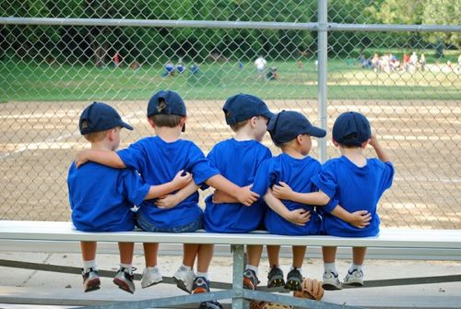
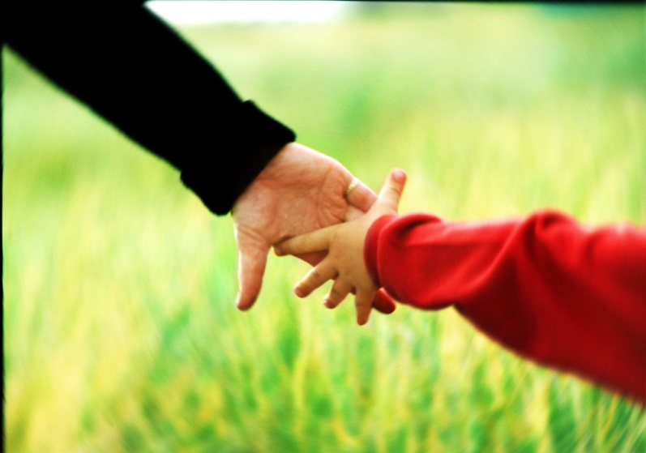
What Helps Children in these HC Situations?
Relationship with a reliable adult
Buffers from the conflict
Siblings
Warmth
Affection
Counselling
Appropriate peer support
Activities in which they
can find mastery

Slide 65
What Parents Can Do

Slide 66
What Parents Can Do
Communicate with the children and explain the divorce in an age appropriate manner.
Give children a voice but do not burden them with the choice.
Lead the children through the process in a respectful manner.
Endorse and support the attachment between the children and both parents.
Allow children to grieve and express their emotions.
Set up effective co-parenting communication that takes the children out of the middle.

Slide 67
What can the Professionals do?
Address the family system, not just the parents or the children in isolation.
Operate from the guiding principle of the best interests of the children.
Educate parents on the high cost of conflict to their children
Build resiliency in children.
Build resiliency in parents (if possible).
Help build healthy social connections and community engagement.
Provide buffers from the conflict.
Assist in setting up boundaries that minimize negative parental interaction in front of the children.

Slide 68
Professional Interventions
Set up conflict management structures and containment strategies
Parent Coordination (PC)
Collaborative Divorce
Divorce Coaching
Mediation
Custody and access evaluations
Coordinated counselling and team treatment approaches
Intervention programs that are family focused
Child advocacy in divorce process

Slide 69
Building resiliency (AcesConnection.com)
1. Make sure the basic needs of the child are being met.
2. Build resiliency in the parents (as much as possible).
3. Parent education for parents (educate on developmental psychology, parenting skills and educate on the cost of conflict and how this effects the developing brain).
4. Attachment training for parents (aka attachment boot camp).
5. Build alternate social connections for the child.
6. Build social and emotional skills in the child to the best of your ability.

Slide 70
Guide the Adults in Dealing with the Adult Issues
Creating a space in which the adults can deal with the adult issues is one of the most effective ways of reducing the collateral damage of adult conflict on children.
Containment
Respect
Boundaries
Accountability
Education
Compassion
Direction

Slide 71
Why Professionals are Important
They implement strategies to contain conflict.
Parents have often lost perspective- professions can provide perspective again.
Some parents will continue the fight no matter the costs.
By managing the conflict, we can make a difference in the development and well being of a child.
As professionals involved with these families we can make a direct difference to the child by assisting with conflict management and containment.

Slide 72
The Level of Conflict,
and the parent’s ability to manage that conflict,
directly effects the mental health and well being of their children.

Slide 73
“Crisis is an opportunity. How we respond to it can bring out the worst case scenario (destruction) or the best case scenario (growth).”
Alyson Jones
Let’s keep looking for ways to move this in the right direction!

Slide 74
Contact
Alyson Jones & Associates
Alyson Jones, MA, RCC
113-2419 Bellevue Avenue, West Vancouver, V7V 4T4
(604)926-6665
info@alysonjones.ca
www.alysonjones.ca

Slide 75
References and Resources
L.M. Baker, L.M. Williams, M.S. Korgaonkar, R.A. Cohen, J.M. Heaps, R.H. Paul Impact of early vs. late childhood early life stress on brain morphometrics Brain Imaging Behav., 7 (2013), pp. 196–203
Strauch, Barbara, What the new discoveries about the teenage brain tell us about our kids, New York Anchor Books (2003)
Anita Thapar, Gordon Harold, Frances Rice, Kate Langley, Michael O'Donovan. The contribution of gene–environment interaction to psychopathology. Development and Psychopathology, 2007; 19 (04) DOI:
Cummings, E. M., & Davies, P. T. (1994). Children and marital conflict: The impact of family dispute and resolution. Guilford series on social and emotional development. NewYork, NY, US: Guilford Press.
Cummings, E., & Davies, P. T. (2010). Marital conflict and children: An emotional security perspective. New York: Guilford.
Cummings, E. M., Ballard, M., El-Sheikh, M., & Lake, M. (1991). Resolution and children's responses to interadult anger. Developmental Psychology, 27, 462–470.
Davies, P. T., & Cummings, E. M. (1994). Marital conflict and child adjustment: An emotional security hypothesis.
Katz, L.F., & Gottman, J.M. (1993). Patterns of marital conflict predict children’s internalizing and externalizing behaviors.
Developmental Psychology, 29, 940-950.
Kelly, J. B. (1982). Divorce: The adult experience. In B. Wolman and G. Stricker(Eds.),Handbook of developmental psychology. New Jersey: Prentice-Hall.
Kelly, J. B. (2000). Children’s adjustment in conflicted marriage and divorce: A decade review of research.

