Slide 1
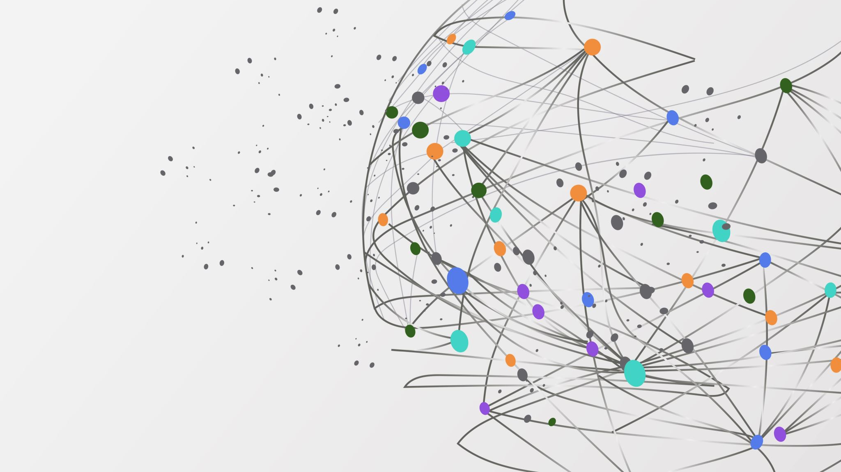
The magic of transformational interventions - learning by doing
IACP Orlando 2022 27 Oct – 30 Oct
Collaborative Magic – 23rd Annual Networking & Education Forum
René de Haas, Annelies Verhoeff and Ingeborg Sandig

Slide 2
INTRODUCTION

Slide 3
Three systems
Partner system
Parent system
Child system
Woman
Man
Mother
Father
Child

Slide 4
Three systems
Partner system
Parent system
Child system
Woman
Man
Mother
Father
Child

Slide 5
Partner system
Motives for the divorce
Pain from the past
History of the relationship
Family of origin
Conflict styles
Patterns in arguments
Forgiveness
Feelings / emotions thermometer
EFT – circle
Dynamics of the relationship

Slide 6
Parent system
(LSD) Listening, Summarize and Delve further
Core qualities
The needs from each other as parents
Transactional analysis
Drama triangle / winners triangle
From blaming each other to talking in wishes and asking questions
Joint values
Temple of Posthumus
Ritual

Slide 7
Child system
Child conversation

Slide 8
Partner system

Slide 9
Motives for the divorce
Clarify motives for the divorce
Listening to each other
Check, double check
Understanding
Acceptance ?

Slide 10
Pain from the past
Bang - Fear
Boos - Anger
Blij - Happiness
Bedroefd - Sadness
Body

Slide 11
History of the relationship
How did you meet?
What came up / characteristics inside and outside
Expectations / disappointments
Development relationship
Reasons for the break up
Acceptance ?

Slide 12
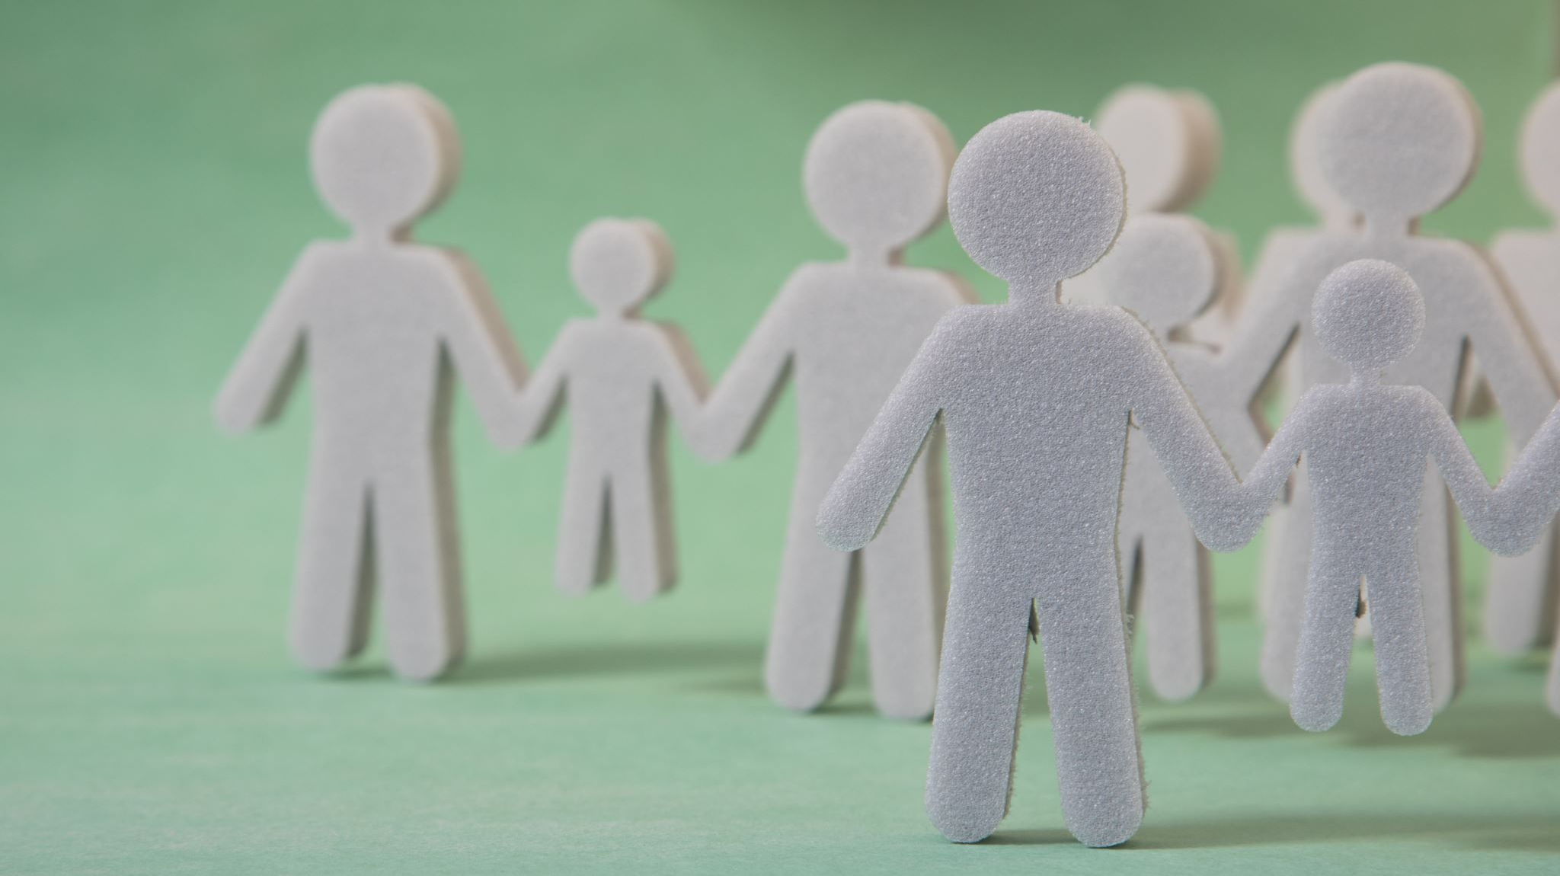
Family of origin
How did you experience your parents as a child ( + or - )
Describe your parents
Dynamics in their relationship, the way they quarrel and how did they solve it?
What did you learn from your parents at this point?
Describe your own conflict style step by step

Slide 13
Family of origin

Slide 14
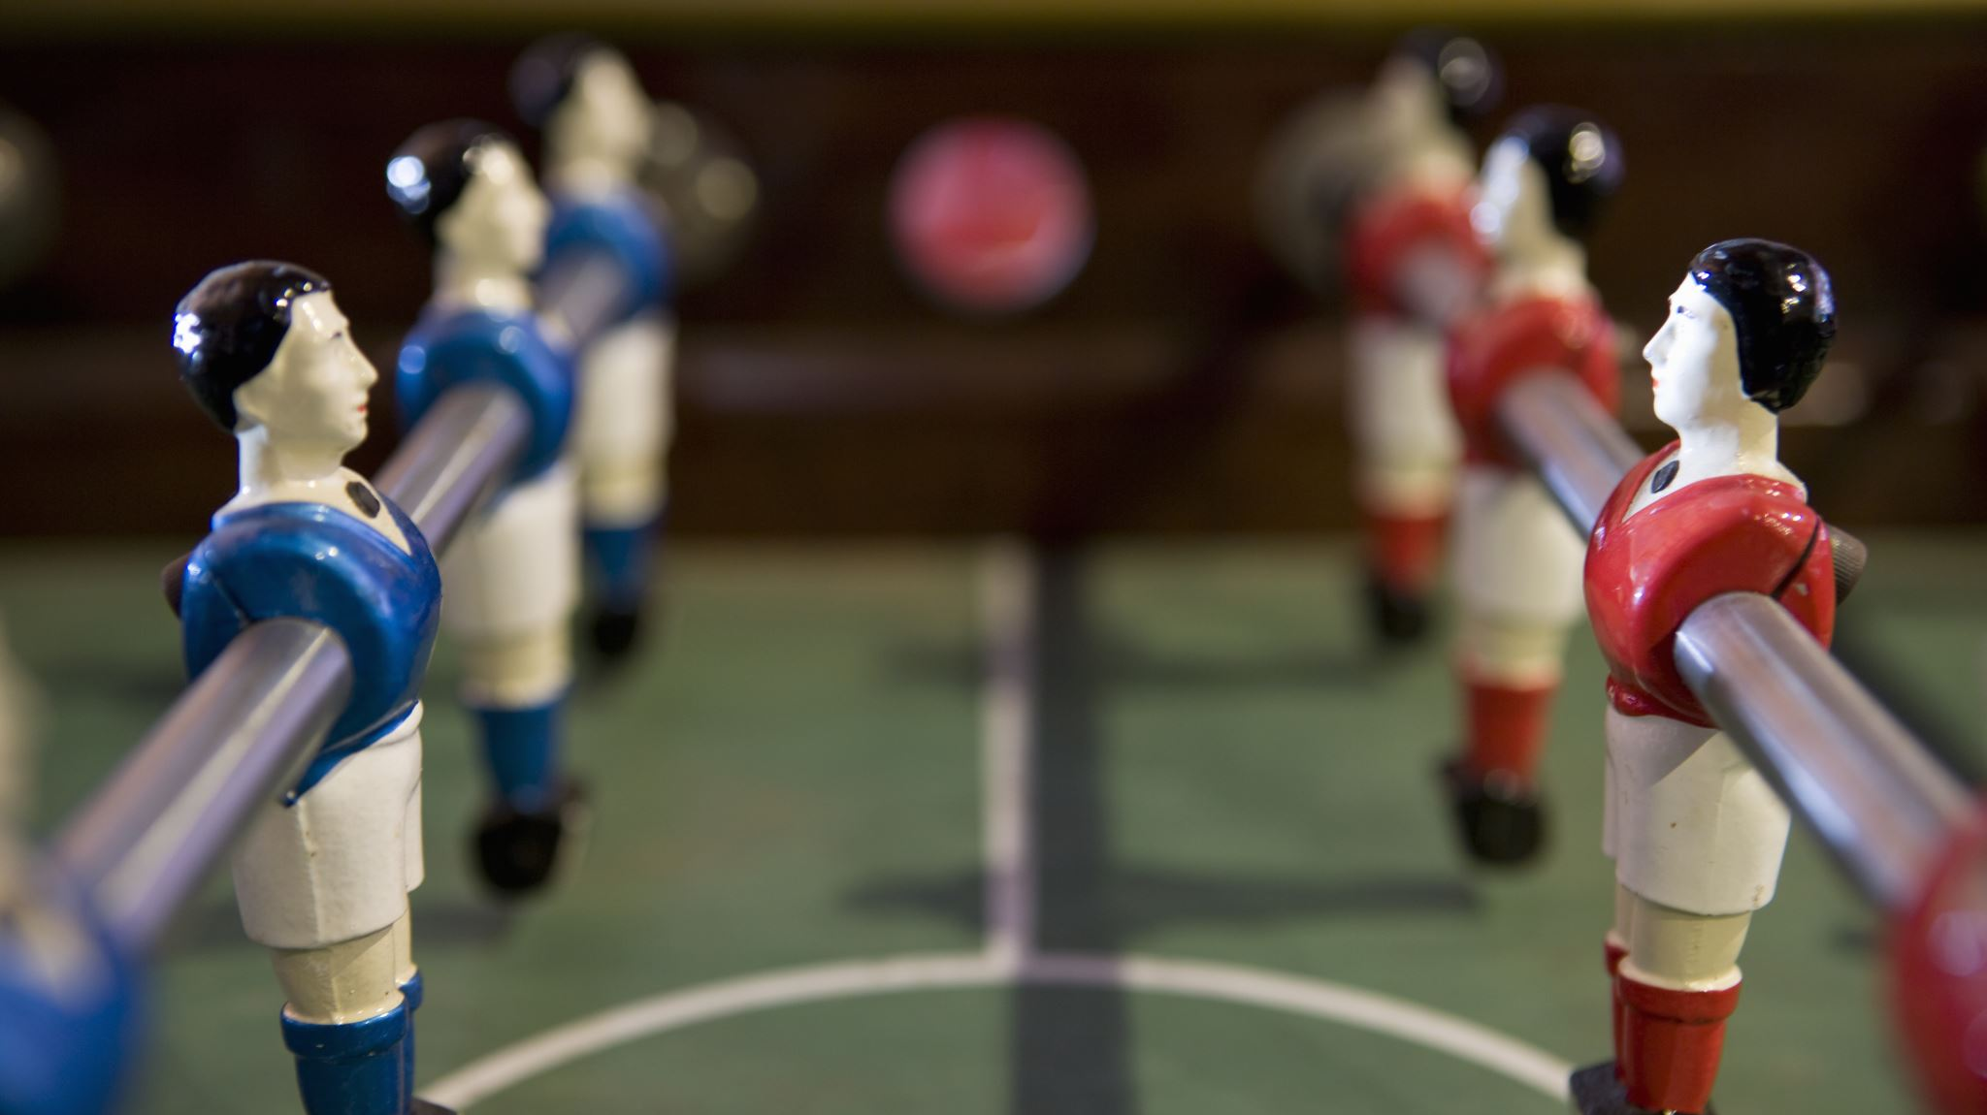
Conflict styles
Three types of relationships:
Autonomic / Symmetric escalation
Consultation / Interpunction
Complementary / Push and withdraw
The BreakUp - fighting scene (2006) - YouTube

Slide 15
Conflict styles

Slide 16
Feelings / emotions thermometer

Slide 17
Feelings / emotions thermometer

Slide 18
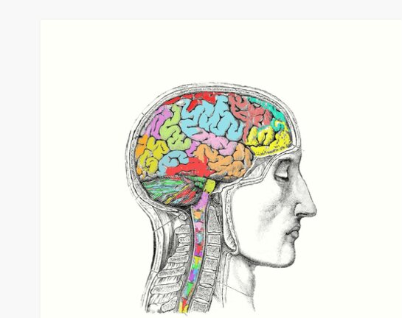
Emotions thermometer
EMOTIONS
RATIO
REFLEXES

Slide 19
Patterns in arguments
Fight smarter: avoid the most common argument patterns

Slide 20
Forgiveness

Slide 21
Forgiveness

Slide 22
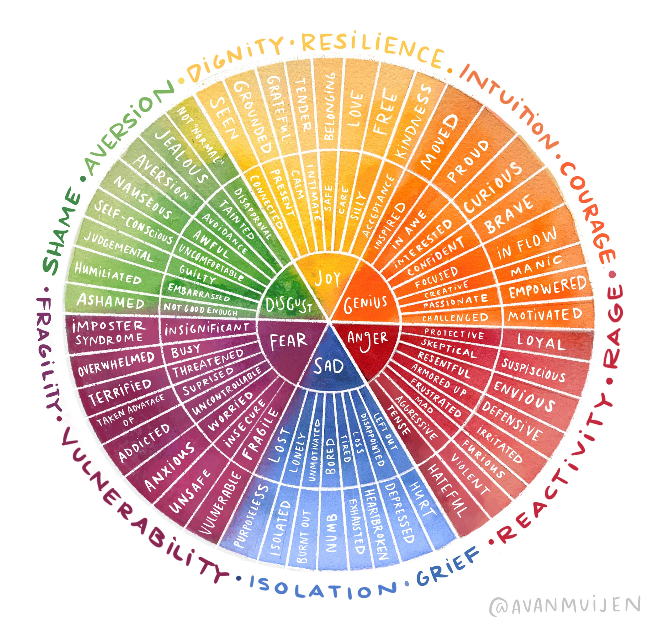
EFT – circle

Slide 23
Demo the circle
Behaviour
Secundary emotions
Secundary emotions
Primary emotions
Primary emotions
Attachment needs

Slide 24
EFT skills and exercises
Secundary emotions
Behaviour
Anger
Silent
I do not feel acknowledged
I withdraw
Primary emotions
Need for attachment

Slide 25
Role play in CD / Demonstration
Man (Dutch) is a psychiatrist
Woman (Australian) is a teacher
Three little boys of 5, 7 and 9 years old
Man does not want to divorce and woman misses her country of origin (Australia)
The man has a lot of fears that the woman will leave the country with the kids; during the relationship as well as during the divorce
The man has a strong support system in The Netherlands. The woman only has relatives in Australia and the USA

Slide 26
Which EFT interventions?
Meeting where they are. Present.
Observing behaviour and emotions.
Polka. Escalation.
Woman accuses: “You are dominant, always in accordance with your wishes. My culture is not represented.”
Man withdraws: “Whatever I do, it is never okay. It is so painfull”.
Confirm 5 emotions:
Back to the past. How did you meet? What happened?
Mutual attractions. Fear not be seen. Attachment-trauma.
Family of origin. What felt unsafe? She: mother always mourning. Unfaithful. Shouting for attention. Fear for domination. He: child of divorced parents. Fights. Escape-behaviour. “no one sees me”. Fear for exclusion.
Pittfalls.
Future.
Recognition.
Elements of reinforcement as ex-partners and building to co-parents.
Challenges and wishes – confirm, clarification, softening, listening, making time, asking questions, formulating wishes, no blame-game.

Slide 27
Parent system

Slide 28
(LSD) Listening, Summarize and Delve further

Slide 29
Core quadrants
Core quality
Pitfall
Allergy
Challenge

Slide 30
EXAMPLE CORE QUADRANTS
WOMAN
MAN
Real self
Alone
Loyalty
Lose yourself
Faker
Reconnect
Ego
Care for yourself

Slide 31
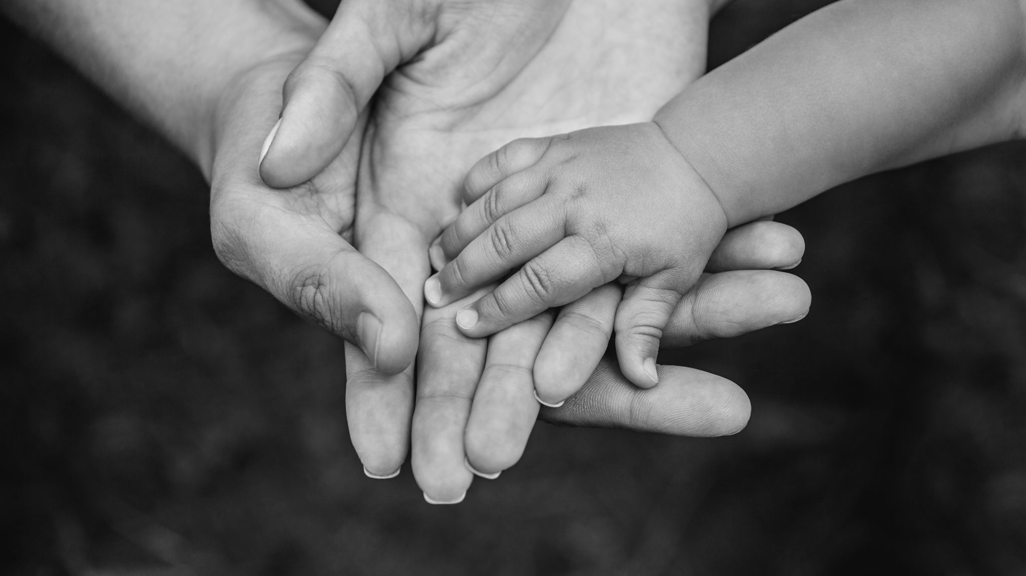
The needs from each other as parents

Slide 32
Drama triangle
Persecutor
Rescuer
Victim

Slide 33
Drama triangle / winners triangle
Persecutor
Rescuer
Victim
Creator
Challenger
Coach

Slide 34
From blaming each other to talking in wishes and asking questions

Slide 35
Transactional analysis
PARENT
PARENT
ADULT
ADULT
CHILD
CHILD

Slide 36
Transactional Analysis
Critical parent
Judgemental
Authoritative
Structuring
Nuturing parent
Encouriging
Supportive
Comforting
PARENT
PARENT
Adult
Facts
Arguments
Ratio
Negotiation
ADULT
ADULT
Adapted Child
Collaborting normally
Free child
Curious
Spontaneous
Energetic
CHILD
CHILD
Rebellious child
Rebellious
Complaining

Slide 37
Temple of Posthumus
Caring
Sharing
Loving
Commitment
Respect
Trust
Love
Communication
Acknowledgement

Slide 38
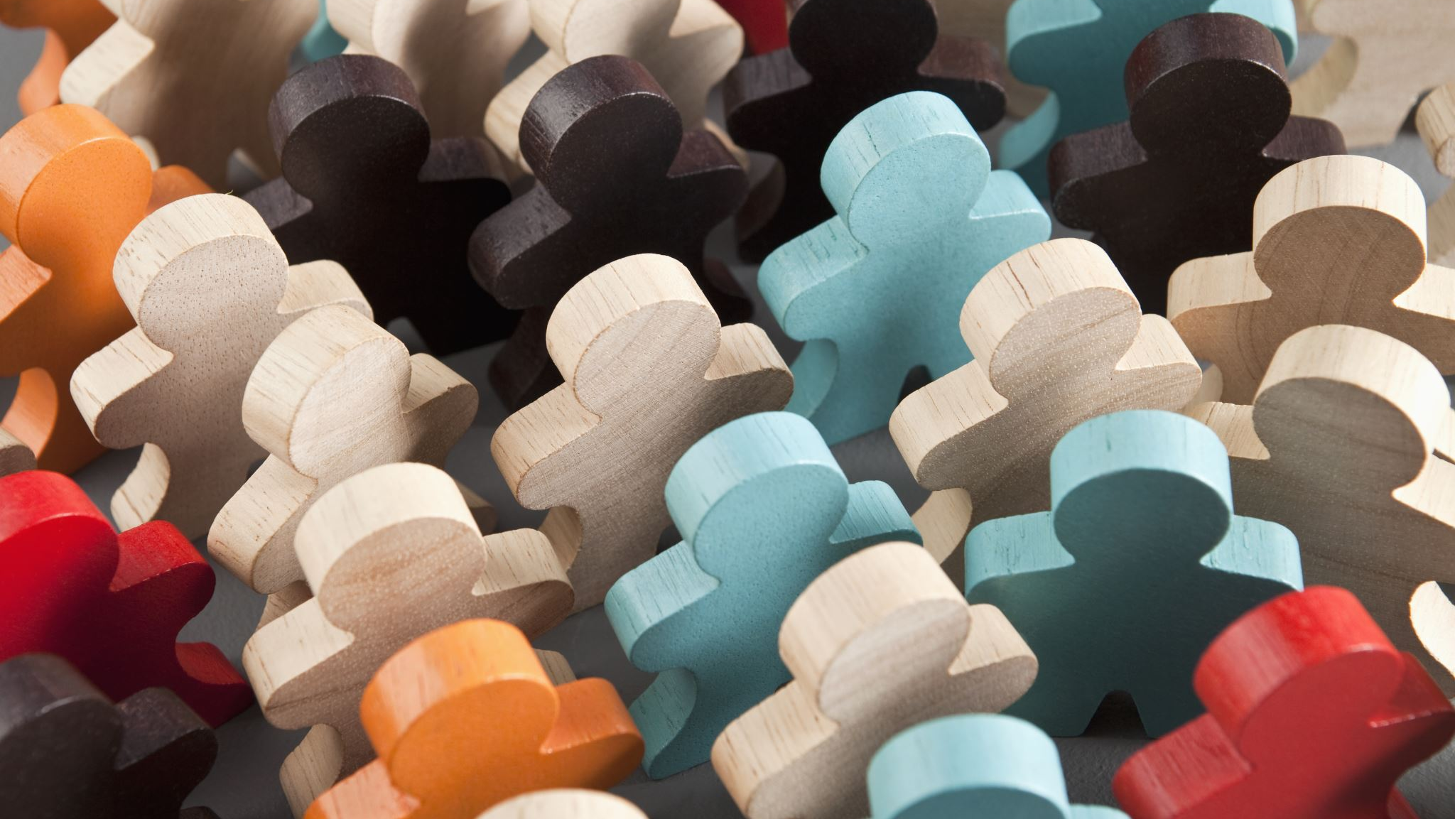
Values

Slide 39
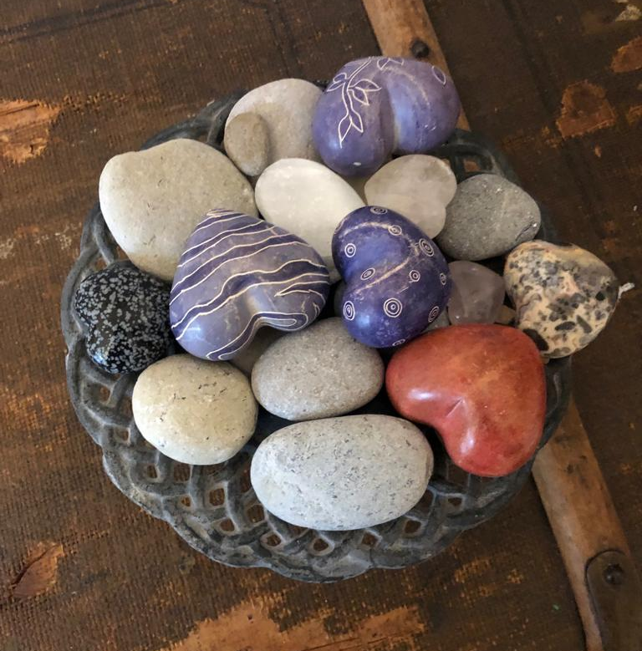
Ritual

Slide 40
Child system
Child conversation

Slide 41
The child conversation
Start together with all the children
Explain the purpose of the conversation and that you will never ask whom they love the most and where they want to live.
Verify with the children if you can tell their parents (and/or court) everything that they have told you
Conversation with the children one on one
General perception of the child at that moment (school, friends, at home, what does a normal day look like and the weekends)
Perception of the child with respect to the divorce
Perception about their emotions (three wishes and tips for the parents)
Feedback with the parents

Slide 42
Contract between the child and the parents

Slide 43
Article Collaborative Review May 2019

Slide 44
Questions

Slide 45
Closing
Take away

