Slide 1
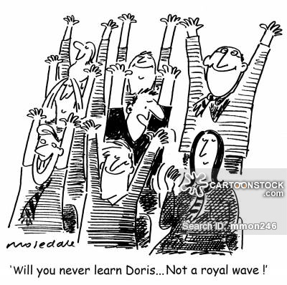
Stadium Wave
We use teamwork to coordinate our movements and notice how we depend on each other to reach our goals
At the Professional Meeting before the clients enter
One team member will start the wave (alternate each meeting)
Speed it up
Change directions

Slide 2
HEALING The helpers: Understanding & Overcoming Compassion fatigue
Deborah K. Gilman, Ph.D., Licensed Psychologist, IATP Certified Compassion Fatigue Professional, Mindfulness Certification: Institute for Meditation and Psychotherapy
Lisa Standish, Esq., Certified Yoga & Pilates Instructor

Slide 3
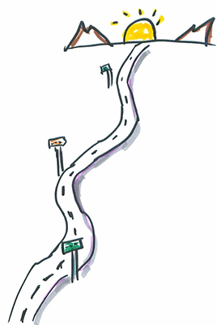
objectives
Learn how stress impacts the mind and body
Differentiate between burnout and compassion fatigue
Learn how external and internal factors can impact our ability to manage stress and lead to compassion fatigue
Discuss symptoms of compassion fatigue that can disrupt team functioning.
Learn wellness ideas to promote overall health of individual professionals and the collaborative team
Evaluate and balance your experiences as a professional and as a person, exploring how your career experiences may alter your world view and work as a collaborative team member.

Slide 4
Hello game
When we say hello, we connect with each member of our team
Notice something about the team member
Use the prompt :“Your eyes look brown today”; “Your shirt looks green today”
The prompt “Your eyes LOOK” rather than “Your eyes are”
Practice observing without judging, analyzing, or jumping to conclusions

Slide 5
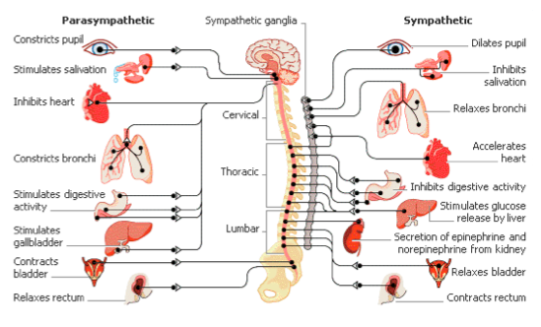
Stress: Physiological experience
Perceived threat triggers Sympathetic Nervous System (SNS) to prepare body
“Fight or Flight”
Heart Rate, Respiration, and Blood Pressure INCREASE
Cortisol & Adrenaline (stress hormones) INCREASE
Parasympathetic Nervous System (PNS) DECREASE (rest and digest system)

Slide 6
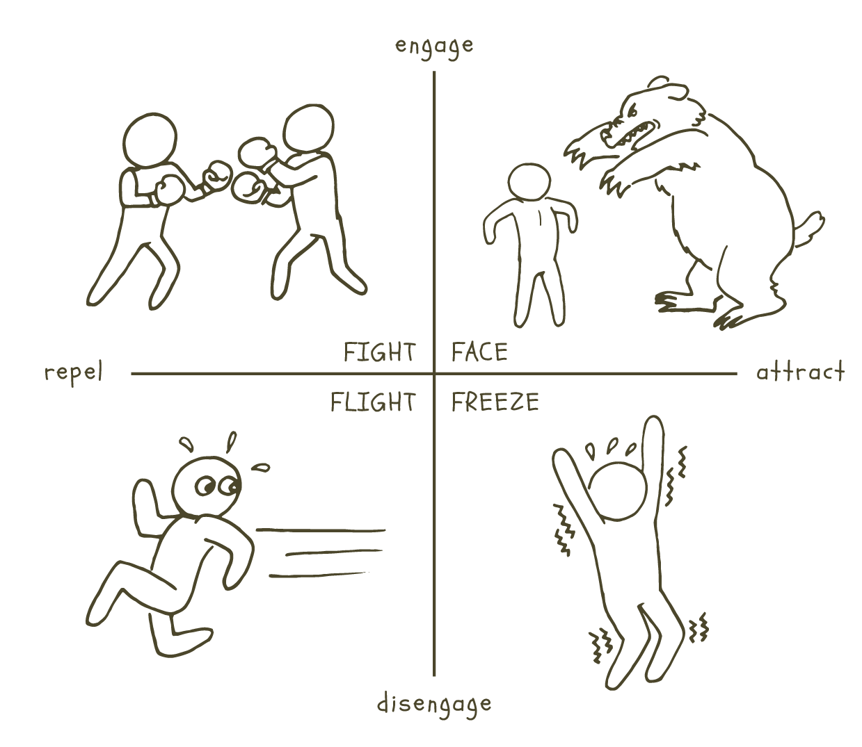
Fight, Flight, Freeze

Slide 7
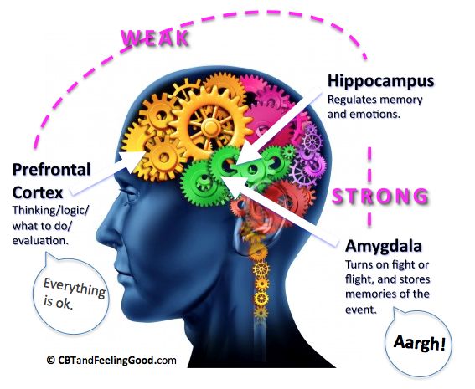
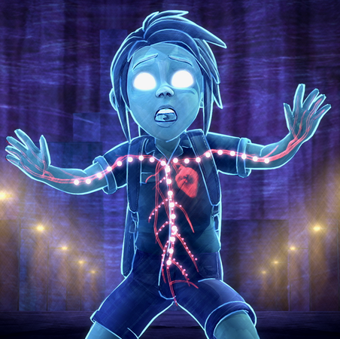
Acute Stress Response
Thinking Brain
Survival Brain
Notes:
Suggested Presentation Language
Next we have the “thinking part” of our brain involved in the stress response- the prefrontal cortex and the hippocampus. The prefrontal cortex, (responsible for abstract thinking, planning, emotional regulation) has the potential to help us reason through the situation and think logically about what to do. The hippocampus helps us encode information about the context of the event—to provide some framing for the intense emotional memory. When all of these systems work together and in balance, we have an incredibly effective stress response system that helps keep us safe from danger and learn from past experiences.
References
Center on the Developing Child. Toxic stress: Key concepts. Harvard University. Retrieved from http://developingchild.harvard.edu/science/key-concepts/toxic-stress/
Image: Pritzker, K. (Producer), & Redford, J. (Director). (2015). Resilience. [Motion Picture]. United States: KDJR Films. Retrieved from www.cbtandfeelinggood.com

Slide 8
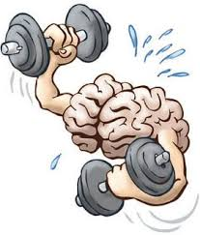
Effects of Chronic Trauma
Thinking Brain
Survival Brain
Notes:
Suggested Presentation Language
They may be accessing their “survival brain” often as a result. When we have to have to call on that system again and again, that leaves its mark on our use-dependent brains (Perry et. al., 1995). Hebb’s rule, “neurons that fire together wire together,” (Hebb, 1949) underscores how the repeated activation of the fear response and its associated neural networks affects people who have experienced chronic trauma. Over time, our “survival brain” becomes really strong due to its frequent use and our thinking brain becomes weak in comparison.
One implication is that the threat detection system becomes hypervigiliant (always on the lookout for danger) and our amygdala is more readily triggered. Additionally, the “thinking brain” is less able to oversee physical and emotional regulation, impulse control, insight, empathy and critical thinking. (Craig, 2015, p.22)
References
Craig, S. (2015). Trauma-Sensitive Schools: Learning Communities Transforming Children's Lives, K-5. New York: Teachers College
Press.
Perry, B., Pollard, R., Blakley, T., Baker, W., Vigilante, D., Scheeringa, Michael S., & Osofsky, Joy D. (1995). Childhood trauma, the neurobiology of adaptation, and “use‐dependent” development of the brain: How “states” become “traits”. Infant Mental Health Journal, 16(4), 271-291.
Hebb, D. (1949). The organization of behavior; a neuropsychological theory. (A Wiley book in clinical psychology). New York: Wiley.
Image: Pritzker, K. (Producer), & Redford, J. (Director). (2015). Resilience. [Motion Picture]. United States: KDJR Films. Retrieved from www.cbtandfeelinggood.com
Image (brains/weights): Retrieved from http://www.lessonpaths.com/learn/i/goals-and-investment-workshop/brain-lifting-weights-graphic

Slide 9
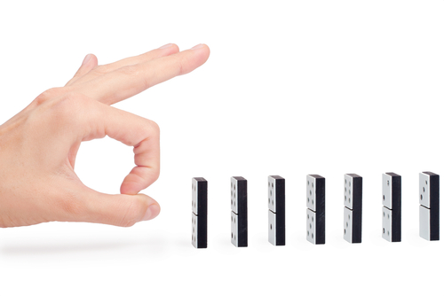
Think about some of the client behaviors you observe in your meetings. What are some of the ways that “survival” brain shows up?
How do some of these behaviors fit into the context of flight, fight or freeze?
Notes:
Suggested Presentation Language
So, what does all of this mean for the classroom? We want you to spend a few minutes thinking about what this might look like in the classroom. Please read the questions above, then turn & talk with your neighbor.
Presentation Note: Provide teachers with 5 minutes to discuss with a peer and then share-out with the group.
Background Information:
The goal here is to have them start to contextualize some of the behaviors through a trauma lens.
References
Adapted from Souers, K., Hall, P. (2016). Fostering Resilient Learners: Strategies for Creating a Trauma-Sensitive Classroom. ACSD.
Image (Turn and Talk): Hunter, M. Retrieved from https://clipartfest.com/download/ebc68f0335dc20a9519b1c4e74b7035b9a7713fb.html
Image (Dominos): Retrieved from https://www.colourbox.com/image/hand-and-dominoes-image-6081349

Slide 10
Balloon breaths
Deep ‘diaphragmatic breathing’
Your diaphragm moves down and pushes your stomach out as you take in a breath
Rather than shallower higher lung breathing

Slide 11
Warning signs

Slide 12
Personal indicators of stress reflection

Slide 13
Understanding the Cost of Caring
Expectation: walk through water without getting wet
The way we deal with suffering and loss shapes our capacity to be present with our teams and clients
The way we protect ourselves from the stress of loss and suffering may be the way we distance ourselves from life
Do we give ourselves enough time to heal so we can care?

Slide 14
What is Compassion Fatigue?
Burnout
Secondary Traumatic Stress

Slide 15
Compassion Fatigue vs burnout
Compassion Fatigue | Burnout
Refers to the symptoms that result from working with clients who are suffering (Figley, 1999) | Burn-out is the physical and emotional exhaustion workers feel when job satisfaction is low and powerlessness is high (Beth Stamm, 1999)
Profound emotional & physical exhaustion that helping professionals can develop due to exposure to one case or multiple exposure over the course of career | Demands outweigh resources
WORK HARDER and WORK MORE (heroes) | WORK LESS and MORE APATHY and MORE ABSENT (helpless)

Slide 16
Professional Quality of life
Professional Quality of Life
Compassion Satisfaction
Compassion Fatigue
Burnout
Secondary Trauma

Slide 17
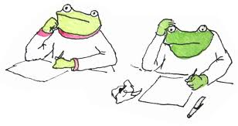
Reflection
Share with the group 3 signs of secondary traumatic stress that you have noticed in yourself or experienced in the past.
Share 3 ways in which you have been positively impacted by the work you do (e.g., what benefits do you experience from the work?).
Notes:
Suggested Presentation Language
The reality is, many of us may have experienced some of these symptoms. We are going to spend some time reflecting on all of the ways we are impacted by our work. On the top of your page write down 3 signs of secondary traumatic stress that you have noticed in yourself or may have experienced in the past. And then spend some time reflecting on all the ways you are positively impacted by the work that you do. Write down three of those. In maintaining transparency and trustworthiness, we want to let you know that we will be collecting your reflections and reading them out loud so, please don’t write your name or other identifiers on your paper. When you are done please raise your paper in the air and we will come around to collect them.
Presentation Note: approximately 30 minutes needed for activity and discussion (next slide) depending on size of group. If group is very large, have them write only 2. Presenters will collect papers and read the STS (negative impact) list first.
References
Adapted from Giller, E., Vermilyea, E., & Steele, T. (2006). Risking Connection. Journal of Trauma Practice, 5(1), 65-82.
Image: ***I CAN’T FIND A SOURCE FOR THE IMAGE***

Slide 18
Complex relationships
Professional Quality of Life
Work Environment
Compassion Satisfaction (ProQOL CS)
Exhaustion
Client Environment
Compassion Fatigue
Depressed by Work Environment
(ProQOL Burnout)
Frustration Anger
Secondary Exposure (ProQOL STS)
Personal Environment
Traumatized by work
Primary Exposure

Slide 19
We bring ourselves
Bring A Past And A Present To Anything We Do
Schemas and beliefs
Stigma beliefs
Social support systems
Positive support
Negative support
History of trauma and illness
Families and close others
Economic situation
Education level

Slide 20
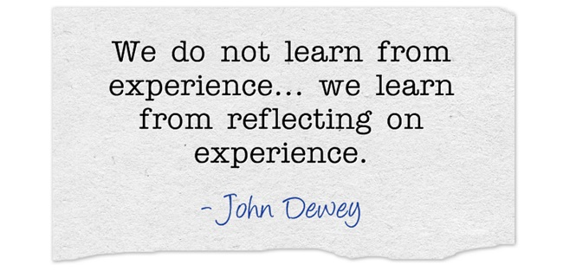
areas to consider
Client Characteristics
Team characteristics
Helper characteristics

Slide 21
Client characteristics
Demographic characteristics of the client
Personality characteristics
Very demanding client who makes frequent requests for extra crisis meetings or telephones regularly in crisis
Defense mechanisms coping skills
“resistant” client who challenges the team every step of the way
Highly emotional or hopeless client
Working with emotionally charged issues in a client, such as child sexual abuse, rape or violence
Moral or ethical dilemma involved in their story?
What is the client’s role in the story?

Slide 22
Team characteristics
Are the team’s resources sufficient for the task at hand
Outside resources or services needed for the team to be successful, are these resources available?
Being overwhelmed by emails and communications
Being assigned too many cases or a large number of difficult cases
Role conflict or role ambiguity
Interpersonal conflict
Professional isolation (only person in firm doing collaborative)
Productivity demands

Slide 23
Helper characteristics
Demographic characteristics of the helper and how closely do they match or differ from those of the client?
What are the personal beliefs, ideological systems, and preconceptions of the helper relevant to the situation and issues presented by the client?
What defensive styles and mechanisms are used by the helper?
What have the professional’s own life experiences been? Has the helper successfully worked through or healed from own experience?
How much training and professional experience has the helper had?

Slide 24
Internal Beliefs
My clients should always like me
Automatic
Thoughts
There is no progress.
Behavioral Reactions
Withdrawal/Detachment
Emotional Reactions
Irritability
Anger
I am not helping this client at all.
This person’s situation is so realistically terrible that there is nothing I can do to help.
We should never have difficult meetings;
My client should appreciate me
I should not ask for advice or support from colleagues or get professional help myself.
Frustration
Sadness
Anxiety
Avoidance
Enmeshment
Chronic lateness
Over-scheduled
I always get the hard cases

Slide 25
Silent Witness (small group exercise)
Discuss a case that caused you to take it home with you.
Note Client, Helper, and Team Characteristics
1
Identify what factors impacted you - internal & external
note commonalities
2
Share these findings with the larger group
3

Slide 26
Building Individual resilience

Slide 27
self-scanning: Thoughts, feelings, behaviors
Am I feeling any negative reactions, such as frustration, irritation, anxiety, helpless, defensiveness, hopelessness?
Am I engaging in dysfunctional behaviors, such as blaming, demeaning, or controlling, team members or the client(s)?
What predictions am I making about today’s meeting? How am I anticipating the clients will behave? How am I anticipating what the team interactions will be?
What is my worst fear about the outcome of this meeting or this case? If this did happen what would this mean about me (I’m a failure, I’m too vulnerable)?
What are my thoughts and beliefs that may be influencing how feel about the current situation?
Do I have any outstanding issues to process with the team? Do I need to ask for support to help me deal effectively with the situation?

Slide 28
“Power Poses” amy cuddy, 2012
Invent a Personal “Power Pose”
Stand Like This for 2 Minutes Per Day
Increase your testosterone
Decrease your cortisol
“Magically” feel more confident and risk tolerant.
*Combine with breathing to increase relaxation

Slide 29
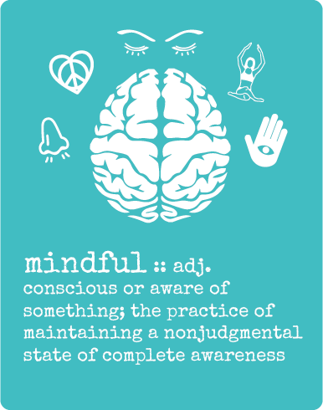
Catch yourself in the moment
Starts with Awareness and Observation: “hmm, what’s going on with me? I seem to be reacting with X response”
Are you in fight/flight/freeze part of your brain? Can you access executive functions?
Enables you to begin to think more strategically
Focus on solutions instead of problems
Move forward with more optimism.

Slide 30
S.O.B.E.R.
S.O.B.E.R.
Stop
Observe what’s going on (I’m mad, can’t think straight, I’m procrastinating)
Breathe (yes, really: take deep, slow breaths)
Expand your thinking about the situation (ask yourself what are three ways that this can work in you favor, or what’s funny about it, etc.)
Respond (figure out how to proactively contend with the circumstances)

Slide 31
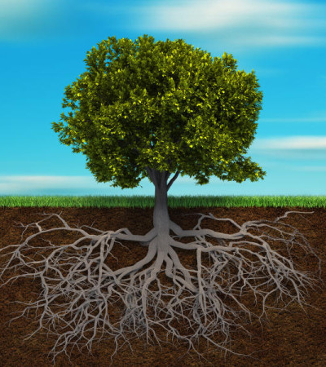
Ground yourself 5-4-3-2-1
Take a deep belly breath to begin.
5 - LOOK: Look around for 5 things that you can see, and say them out loud. For example, you could say, I see the computer, I see the cup, I see the picture frame.
4 - FEEL: Pay attention to your body and think of 4 things that you can feel, and say them out loud. For example, you could say, I feel my feet warm in my socks, I feel the hair on the back of my neck, or I feel the pillow I am sitting on.
3 - LISTEN: Listen for 3 sounds. It could be the sound of traffic outside, the sound of typing or the sound of your tummy rumbling. Say the three things out loud.
2 - SMELL: Say two things you can smell. If you’re allowed to, it’s okay to move to another spot and sniff something. If you can’t smell anything at the moment or you can’t move, then name your 2 favorite smells.
1 - TASTE: Say one thing you can taste. It may be the toothpaste from brushing your teeth, or a mint from after lunch. If you can’t taste anything, then say your favorite thing to taste.
Take another deep belly breath to end.

Slide 32
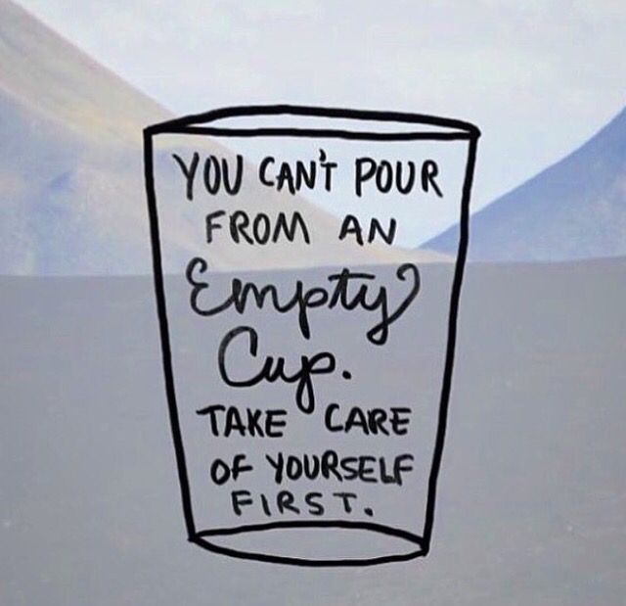
Your resilience plan
What helps you feel refreshed and renewed?

Slide 33
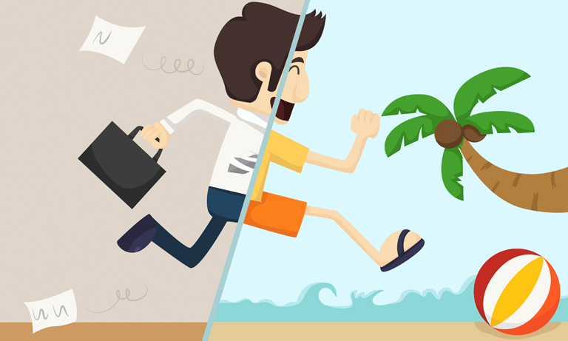
Reflection: leaving work at work
Is there anything that you do that helps you to leave your work at work?
Do you allow yourself any transition time between work and home?
Do you have any ritual that you follow at the end of your work day?

Slide 35
PUTTING IT ALL TOGETHER: DEVELOPING A SELF-CARE PLAN
Physical self care
Psychological self care
Emotional self care
Spiritual self care
Workplace or Professional self care
Find something that works and to be open to the possibility that what works may change over time just as one’s needs and vulnerabilities may evolve as well.
Self care assessment worksheet

Slide 36
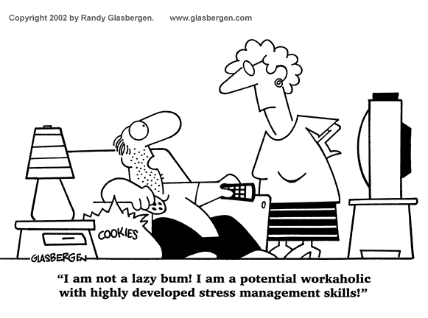

Slide 37
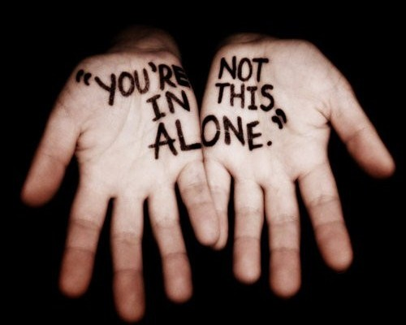
Accessing Systems of Support
Notes:
References
Volk, K. Guarino, K., Grandin, M. and Clervil, R. (2008). What About You? A Workbook for Those Who Work with Others. The National Center on Family Homelessness.
Image: Retrieved from https://mydementedmom.com/2013/01/06/youre-not-in-this-alone/

Slide 38
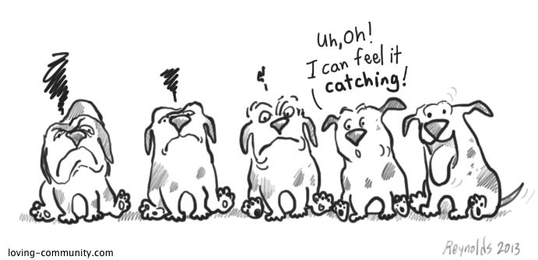
building team resilience
How many people have to be doing their job well for you to do yours?
Peer support can be essential in making your needs a reality
Fostering connection with others is a protective factor in trauma-informed care
Model healthy boundaries for peers/clients
A stable and consistent work force can be a protective factor

Slide 39
Even when we have had challenging meetings, there were also good things that happened in the meeting
Remember that we can feel two things at once
To develop a habit of thankfulness, identify 3 good things during the debrief after each Collaborative Meeting

Slide 40
Appreciation chain
During the Professional Debrief
Each team member notices and states an appreciation for an action of a team member during the meeting.
“I appreciate(d) when you…”
Reframing, encouraging, noticing to increase similar future behavior

Slide 41
Developing a team resilience plan
Not just survival or “getting through” but adapting
Set small goals & celebrate them
Reduces impulsivity and feeling lack of control
Generate Work Satisfaction
Noticing and remembering the joys and achievements of the work we do
Increase Emotional Connection
Individual growth & sharing
Supervision/consultation/mentors
Define roles for team members
Play an active role on the team

Slide 42
“the capacity for compassion and empathy seems to be at the core of our ability to do the work and at the core of our ability to be wounded by the work” - C.Figley
Practice Self Compassion
Reach out to your practice group.
Self Check-in and Body Scanning
Boundaries/limit setting
Check your automatic thoughts

Slide 43
Because I hurt.
Because I matter.
Because my clients matter.
Because the work I do matters.
Because the profession matters.
Because I must.

