Slide 1
HONEY! WE SHRUNK THE CASE…
Presented by
Dr Tina Sinclair | Marguerite Picard | Tricia Peters
Founders of MELCA and Peacemakers for Families

Slide 2
UN Post-disaster recovery steps
Prepare, prepare, prepare
Deploy skilled staff
Know the context
Assess response capacity
Plan operations

Slide 3
Separation and divorce can feel like this

Slide 4
MELCA Disaster Recovery Plan
Prepare, prepare, prepare
Processes and systems set up for when a couple contact MELCA
A pool of highly trained potential team members
Deploy skilled staff
Create a team for the case:
2 x Collaborative Lawyers
1 x MHP/Family Consultant
1 x Financial Neutral
1 x Child Specialist
Know the context
Who are the clients/ what is their situation/ what is important to them

Slide 5
MELCA Disaster Recovery Plan (cont’d)
Assess response capacity
Team capacity to work on this case
Do we need to modify our process
What additional support is needed for these clients
Plan operations
Set up project management of the case
Identify tasks that need to be undertaken
Who is the best person to do those tasks
Timeline for completion of the tasks

Slide 6
More than dealing with the ‘disaster’
Provide opportunities for transformation
Future disaster risk reduction
Strengthen capacity and build resilience
Identify innovative solutions for expected challenges

Slide 7
Overview of today’s seminar
Introduce MELCA 5-step model
First meeting with client
Discovery / Intake
Foundation
Preparation for 1st collaborative meeting
Q&A

Slide 8
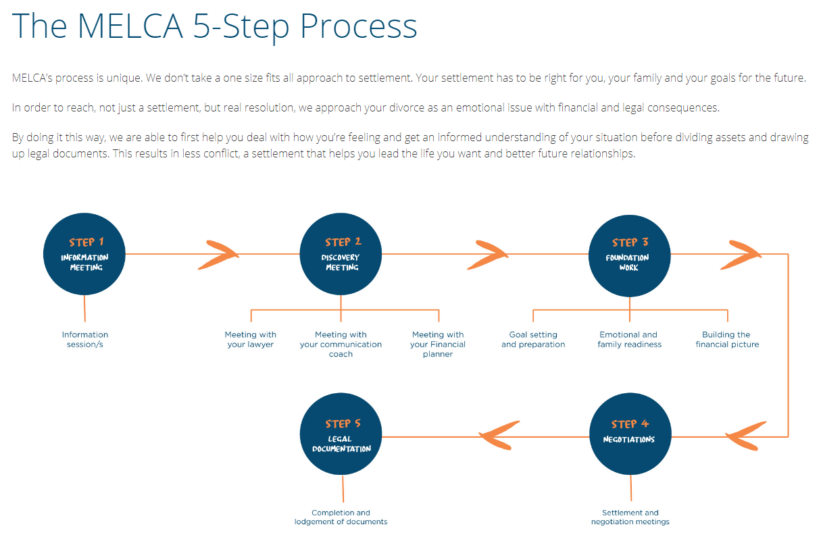
MELCA 5-step process overview

Slide 9
First client meeting – Information meeting
How to talk to clients about interdisciplinary collaboration
A very different first meeting discussion
How do you do this
Watch video and note down any differences between what you do and what you see Marguerite do

Slide 10
Discovery meetings (Intake)
Where the team gets to understand and assess the needs of the clients
2 ½ hours clients meet team members
Structure
Each client meets their lawyer - 1 hour each
Each client meets the financial neutral - ½ hour each
Each client meets the MHP - ½ hour each
Both clients meet the MHP together - ½ hour together
Team conference at the end to learn about the client needs and scope the work

Slide 11
What is the lawyer doing in Discovery?
Listening for the story, reassuring, using active listening, reframing, looping etc
Gauging what their burning issues are
Listening for a sense of how they see the end of their relationship and how they see their former partner; with anger, contempt, mistrust, for example
Ensuring that I have a sense of the big issues about parenting, conflict, relationship dynamic, assets, assumptions about “the law”, and money issues
Asking what they are wanting or expecting of their settlement process, what they value, why collaboration

Slide 12
What is the financial neutral doing?
Listening for their attitude around money – fear, abundance, scarcity
Getting an idea about how money was managed in their household
Getting an idea about how the bigger money/investment decisions were made
Gauging whether they have the same understanding about what went on in the household around money
Looking for abuse and control issues around money
Listening for any blame around their financial situation
Assessing financial literacy
Listening for their ideas about their financial future
Assessing for any urgent money issues
Gauging whether money was something that caused tension/arguments between them
Getting a big picture understanding of the financial situation

Slide 13
What is the MHP doing? (Clients separately)
Brief summary of events precipitating the end of the relationship
Has the separation decision been made
Assess level of safety
Assess capacity to sit together and discuss/negotiate
Capacity to empathize and get into the other’s shoes
Build a genogram
Parenting roles, capacity, respect for each other
Relationships with children, if they have been told about the separation
Influence of others
Family of origin issues, their own history/opinion of divorce
What are they most concerned about
What is the most important for them as outcome

Slide 14
What is the MHP doing? (clients together)
Check in with how well they are processing all the information
Opinions/commitment to collaboration
Is this joint time something they are able to do and have done recently – or need help to talk together
Anything immediate they wish to say or discuss [this allows for closure conversation or interim mediated agreements either then or make another time]
Validate each other as parents if possible, or any other role which has benefited the other
Plan for what happens next as well as when they leave

Slide 15
Foundation work
Focused on the work that is necessary to prepare the clients and the team for the first negotiation meeting
Goal setting and preparation for negotiation stage
Emotional and family readiness
Building the financial picture
Team communication and planning
Scoping the work for first negotiation meeting

Slide 16
What is the lawyer doing in Foundation
Building a trusting relationship, offering empathy, validation, reassurance that this can be done, building confidence and optimism, hearing what’s still burning
Coaching on perspective, conflict, bringing to the table what will work for them and ‘letting go’, reality checking
Shifting focusing to the future
Goal setting
Meeting preparation: structure, roles, advocacy, the collaborative agreement

Slide 17
What is the financial neutral doing?
Collecting financial data, and information about how the couple have lived their lives in the past
Helping with budgets for new single life – shifting focus to the future
Building financial knowledge and confidence and reducing fears
Reshaping unrealistic expectations
Listening for the important goals and thinking about how they could be met financially
Looking for financial red flags, eg tax, pension plans, debt management
Coaching to focus on what will serve them and what they can let go of

Slide 18
What is the MHP doing?
Assess client readiness and what preparation is needed to make the first negotiation meeting successful
Consider pacing of the rest of the case
Where is client anxiety level
Where is client emotionally - in the phases of grief
How is client cognitively
Are they more past or future focused
Assess team dynamics and team function/dysfunction

Slide 19
Challenges that have arisen in Foundation
Hearing about:
a new relationship
an intention to relocate
recent episodes of conflict between them
Client saying they will leave the process or being demanding / anxious / depressed
Unrealistic and stuck positions
Precarious financial positions, eg potential debt foreclosure, potential bankruptcy
Expectation that financial neutral is the financial ‘arbiter’, knows the optimal settlement

Slide 20
Challenges that have arisen in Foundation
Flip flop of client mood aligning with change of mind re settlement options
Lack of follow through with one client’s previous agreement(s) –creating conflict
Delays and ramifications
Client energy/capacity/knowledge unbalanced,
Team issues – attitude towards delays, prejudicial attitude to one of the clients, alignment of a team member, communication not tight, professionals not following through

Slide 21
Preparation for 1st negotiation meeting
Team communication at end of Foundation
Do we have everything we need
Are the clients ready
Setting the agenda
Team pre-brief
No surprises

Slide 22
Q&A
?
Tasks to follow up from today:
Identify 3 take outs from today’s PIF
Identify 3 things you want to follow up
Identify 3 things you will implement in your practice

