Slide 1
Collaborative Mentorship
The Real Importance of Mentoring

Slide 2
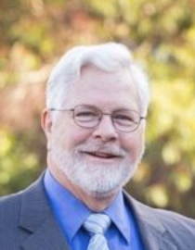
Brenda L. London & George Richardson

Slide 3
Relationship
Collaborative Practice is not transactional
Collaborative Practice is relational

Slide 4
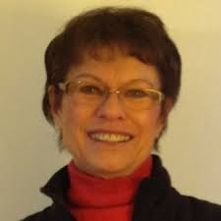
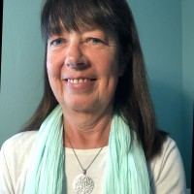
What Mentors have you had in your life?
Grade School
College
Graduate School
Professional

Slide 5
Collaborative Professional
Change Agent

Slide 6
An Excellent Mentor
Relevant expertise in Collaborative Process and Practice
Enthusiasm for sharing information and experience
Eagerness to invest in others
Ability to give honest and direct feedback
Reflective listening skills and empathy
Committed to Collaborative Practice

Slide 7
Not a One-Way Street…

Slide 8
Who?
Newly Trained Collaborative Professionals
Young Professionals
Students
Lawyers, Financial, Mental Health, Allied Professionals

Slide 9
Why?
Build new relationships
Practice expansion & excellence
Community education & growth
Creates thriving practice groups
Sustains growth in state and international organizations
Succession Planning

Slide 10
Types of Mentorship
Informal Social Mentoring
Formal Organizational Mentoring
Individual
Reach Out
Build Relationship
Sustain Relationship
Institutionalized Program
Set Expectations
Time Commitment Structured
Short Term

Slide 11
Formal Practice Group Mentoring
WELCOME AND INTRODUCTION
Have everyone introduce themselves – names and discipline
Read and briefly discuss CFLGCF Vision, Mission, Values
Brief review of CFLGCF new Strategic Planning Initiatives
The Goal of Tonight’s Program, per our strategic plan:
“Help New Members Build a Quality Collaborative Practice”
A. To help new members understand their role and expectations in the Collaborative process
B. To help motivate new members to present Collaborative to their clients
C. To stress to new members the need for additional training
D. To effectively mentor new members
E. To develop a mentality of leadership among our new members (FACP & IACP).

Slide 12
Our Vision, Mission, and Values
Our Vision: As Collaborative professionals, we empower families in transition to accomplish their individual and family goals while minimizing adverse emotional, economic, and legal impacts.
Our Mission: Enriching legal, mental health, and financial professionals by supporting and advancing quality Collaborative Practices, creating awareness, building community and relationship opportunities for members, and providing training and development.
Our Values: Excellence, Respect, Integrity, Transparency, & Innovation

Slide 13
Social Mentoring
Follow-up with newly trained professionals
Invite them to your local practice group meetings
Return emails or phone calls from Collaborative practitioners regarding case questions, practice questions, training questions
Invite newly trained professionals to state or international conferences
Invite newly trained professionals onto a team as a Notetaker
Invite newly trained professionals onto a Clinic or Pro Bono Team

Slide 14
Cultivate Relationship
Are you helping the future of
Collaborative Practice evolve?

Slide 15
Critical Question # 1
What have you done to move Collaborative Practice forward in the last two weeks?

Slide 16
Critical Question #2
Are you helping to make great leaders
in the Collaborative community?

Slide 17
By saying “Yes” to Mentoring
We are saying “Yes” to the next generation of Collaborative Professionals.

