Slide 1
The Child Specialist
Using a Child Specialist to Engage and Maintain Client Collaboration
Notes:
Using a Child Specialist to Engage Clients
Intro to topics:
Child Specialist Overview
Children/Parenting is usually only goal that requires long term collaboration
Opportunities to harness and maintain engagement
Normalizing emotions but directing process to focus on future
Sharing information to coordinate message and reinforce work of team members (emotion & reactions—underlying needs or values)
Kristin: Introduction
Parent Focus
Children in family system-parents hold the power
Support parents to reduce hurting & increase parents skill to help

Slide 2
Essential Tasks of the Child Specialist
Allow kids to retain their childhood- Be the child’s voice while keeping kids out of the divorce process
Give feedback and education to help parents make healthy child-centered decisions in divorce
Reduce conflict and anxiety and increase coping skills for parents and children
Maintain and strengthen child-parent relationships
Increase effective parenting skills during and post-divorce
Notes:
Creating hopeful “Stories” of strength and resilience-Things WILL change but:
Parent’s love remains unchanged
Family is flexible, strong and enduring
Adults are competent and can ultimately meet the challenges successfully
Grief will pass
Everyone deserves to be happy and will find joy again
Children have the freedom to remain kids and enjoy their childhood

Slide 3
Typical Process of CS Work
Notes:
Typical Engagement Process:
Parent interview
Child(ren) interview
Summary write up for Pro-team
Debrief for parents
Additional support-Parents/team

Slide 4
How Parents Often Arrive
“What about the kids? How are we going to tell them?”
“My parent’s got divorced and it was hell for us- I can’t bear that happening to our kids”
“I can’t believe she is a good mother- a good mother does not leave her family”
Notes:
Parents anxiety and conflict wrapped in a “kid problem”:
Can’t think/problem solve- Turtle on their back
Difficulty managing own emotions
Takes focus off meeting kids needs and on conflict
Minimize difficulties
Over-emphasize difficulties
Common areas of conflict
Parenting history
Fear of losing roles/learning new roles
Limit capacity for others growth (they always/never…)
Divorce story
Differences in Pacing
Guilt/anger may drive

Slide 5
Using Conflict to Discover Motivations
Uncover motivation or need that drives the emotion
Reframe with a future focus
Increase hope and confidence in capability
Pair challenges with solutions
Reframe goals in positive/productive manner
Models for clients
Reinforces “as if” expectations
Team communication- opportunities to reinforce/build upon
Notes:
Conflict may reveal unique motivations of parents and opportunities to engage
Reframing and replacing is like CBT
Reinforcing is like ‘Motivational Interviewing’ (pairing the present actions with the stated goal to illuminate the gap)

Slide 6
Parent interview: Planting Seeds for Collaboration
“The Loving Guide”- using Storytelling
Healthy Framework for divorce- Begins with “Divorce Talk”
What really hurts in divorce
Three C’s and one P
Notes:
Parent interview begins to set expectations/model:
“The Loving Guide”- Mountaineering Example (storytelling)
Remain the leader
Make sound decisions
Reassure and comfort in words and actions
Inspire confidence and hope in the future
“Divorce Talk” (Sharing storytelling with children)
What is happening
Why
How things will change/not change
When
What really hurts in divorce (Education and setting expectations)
Conflict that’s scary/frequent
Conflict that challenges kid life
Conflict that interferes with relationships
Parenting not adequate (monitoring/routines/emotional support)

Slide 7
CS Process
Notes:
CS Process Map:
Child(ren) interview

Slide 8
Child Interview: Gathering the Voice of the Child
Gathering Appropriate, useful information only that will help parents make informed decisions
Looking at children’s experience and vulnerabilities and strengths in divorce thru lens of development
“Plant seeds” for parents to nurture
Notes:
Child interview: Gathering the voice of the child
(Individual/one session)
Looking for Appropriate, useful information only
Temperament
Mood
Parent/sibling relationships
Other sources of support (other family, peers, activities/interests)
Significance of Development: can create “vulnerabilities” or strengths
Factors: Cognitive/Emotional/Moral/Social
Not necessarily something the parent’s did “wrong” (can be useful in defusing blame/conflict)
Focuses energy positively on helping children (future focus)
Manage parent’s expectations
Plant seeds for parents to nurture

Slide 9
Birth-2: Attachment “Can I trust the world?”
“She is trying to cut me out-she won’t even know me!” (Dad)
“It’s not about him, he can just wait. She’s a baby and needs mom” (Mom)
Notes:
Birth-2 Attachment: “Can I trust the world?”
Focus on parents
Lack of “memory”- need consistency
Unable to understand/communicate
Unable to regulate self/parents provide nervous system
Attachment needs can challenge residential schedule
Need flexibility/creativity to meet needs
Need cooperation for consistency
*Once breastfeeding established and can pump- increased ability for overnights

Slide 10
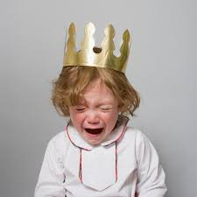
2-4: Autonomy “Is it okay to be me?”
“His tantrums are out of control- he’s really confused” (Mom)
“isn’t that pretty normal for a toddler?” (Dad)
Notes:
2-4: Autonomy “is it okay to be me?”
Focus on parents
Lack of cognitive/Emotional skills
Need for healthy autonomy/stimulating environment
Continued need for attachment/security/Bonding
Tantrums- same approach as non-divorce
Increased difficulty with separations/transitions
Regression of skills/behavior-Stress response

Slide 11
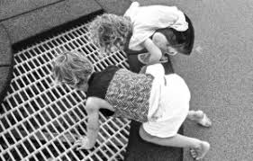
4-6 : Initiative “Is it okay to explore?”
“ I think so. I need to be better so they don’t fight”
(Alec 6 when asked if he thought parents would reunite)
“Mom and dad are getting separate. I’m not sure what that means” (Mia 6)
Notes:
4-6: Initiative “Is it okay to explore?”
Focus on family
Cognitive & emotional limitations
Egocentrism-Control/ lack of awareness where control ends
Imagination- different realities/difficulty fantasy vs. reality
Moral avoidance of punishment (preconventional 1)
Difficulty understanding parenting schedule- cognitive
May feel to blame
May have tantrums/behavioral issues
Somatic complaints
Irrational fears/nightmares
Reunification fantasies

Slide 12
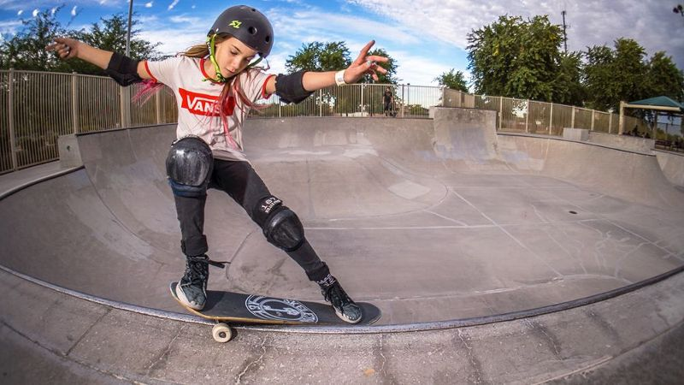
6-12: Competence “Can I make it in the world?”
“It’s not fair, dad doesn’t have as much time- it should be equal” (Brigit 10)
“Dad’s always sad. I try to make him happy. I think he’s lonely without us so I want to stay with him” (Fin 8)
Notes:
6-12: Competence “Can I make it in the world?”
Focus on neighbors/school
Stereotypical rigid moral code (conformity good girl/boy)
Developing imagination- future possibilities
Egocentric and unrealistic sense of power
Increased awareness and control of emotions as well as empathy for other
Moral avoid punishment/exchange favors (preconventional 1&2) to
to good boy/girl (conventional 1)
Loyalty Conflicts-May be concerned with “fair” or “equal” to parents
May fear being “replaced” with new partners or babies
Hiding “negative” emotions for gender
Parentification- Especially emotional caretaking

Slide 13
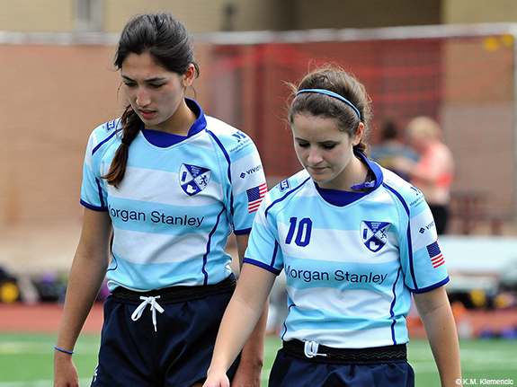
13-19: Identity & Independence “Who am I & what can I be?”
“Mom tells me all this stuff and it’s weird- she’s my mom not my friend and dad has just lost it. I think both of them are behaving like kids” (Kylie 17)
“Dad left us. He cheated on mom so that’s why I think I should get to decide if I go or not.” (Jake 16)
Notes:
13-19: Identity & Independence “Who am I & what can I be?”
Examples of earlier teen: “Who am I”
Focus on peers/role models
Moral codes for self/others- rigid and stereotyped
Good bad/girl (Conventional 3) until H.S.
More sensitive to social/emotional cues, want to “fit in”
Focus on developing life outside the family, developing competence
Loyalty Conflicts-May focus on “blame” of one or both parents
Competencies in school/activities or struggle to perform
Parentification- “Fit in” being perfect, over-responsible for age
Examples of older teen: “What can I be?”
More focus on individual life goals & peer group
Want independence but poor judgment
Feeling/acting adult- but not emotional competence
High level of complexity for school and activities
Moral Dev:
Authority/law & order (Conventional 4) to Social contract (postconventional 5)Possibly universal principal (postconventional 6 usually college)
May withdraw from family to peers/own activities
Fear how divorce will effect their future (can seem selfish)
Less idealization of parents-can be harsh if not meeting needs
May want to make decisions instead of parents
May want flexibility to avoid monitoring/consequences
Parentification- “get into” adult relationship/parents over-sharing, overly held responsible

Slide 14
CS Process Map
Notes:
CS Process Map:
Summary write up for Pro-team
Pro-Team only
Salient aspects that prepare Coach and apprise team
No written document given (verbal only)

Slide 15
CS Process Map
Notes:
CS Process Map:
Debrief for parents

Slide 16
Parent Debrief: Presetnting challenges and strategies for growth
Debrief with coach and both parents present
Child Specialist is neutral “messenger”
Coach manages adult relationship
Convey child info directly but respectfully
Normalize and focus on strengths
Future focus and offer positive strategies
Notes:
Parent debrief in depth:
Debrief with coach and both parents present
Child Specialist is neutral “messenger”
Presence can symbolize the child
Rapport between coach/parent is not confounded
Coach manages adult relationship
Helps parents process difficult information
Coach “holds” the information (accuracy/consistency)
Convey child info directly but respectfully
Tailor information to allow parents to successfully “hear”
Normalize issues or challenges
Provide hope and strategies (utilize strengths)
Provide support for both parents relationship

Slide 17
CS Process Map
Notes:
Additional/Ongoing Support : Still here but in the wings
CS supports for parents and team:
Team meetings with clients (PP’s, kid issues, co-parenting)
Pro-Team meetings
Work with parents/children with team permission
When Therapy is needed- Referrals:
If getting worse rather than better after several months of consistency & stability:
Significant and persistent sleep problems/somatic complaints
Significant behavioral or academic issues at school
Frequent angry or violent outbursts
Withdrawal from loved ones and/or peers

Slide 18
Brick Walls and other Frustrations:
What kid/parent problems that keep coming up?
Notes:
Some ideas:
Kid divorce coaches (Karen)
More standardized and utilized CS’ in and outside of Collaborative (the anti-parent evaluation)
More standardized Parent Coordination (is it co-parent coaching or mediation)
Individual therapy resources that support Collaborative

Slide 19
What’s Missing in Addressing Problems?
What resources or solutions are missing?
Notes:
Some ideas:
Lack of accountability for non-compliant parents
Parental alienation- difficult to diagnose and most interventions take too long and are ineffective
Parents who relocate and don’t acknowledge complexities
Kids refusal of residential time (diagnosing problem, managing parents reactions and conflict)

Slide 20
Keep The Conversation Going…
Twitter #CPCollaborate
IACP Facebook Page
Notes:
Some ideas:
Kid divorce coaches (Karen)
More standardized and utilized CS’ in and outside of Collaborative (the anti-parent evaluation)
More standardized Parent Coordination (is it co-parent coaching or mediation)
Individual therapy resources that support Collaborative

