Slide 1
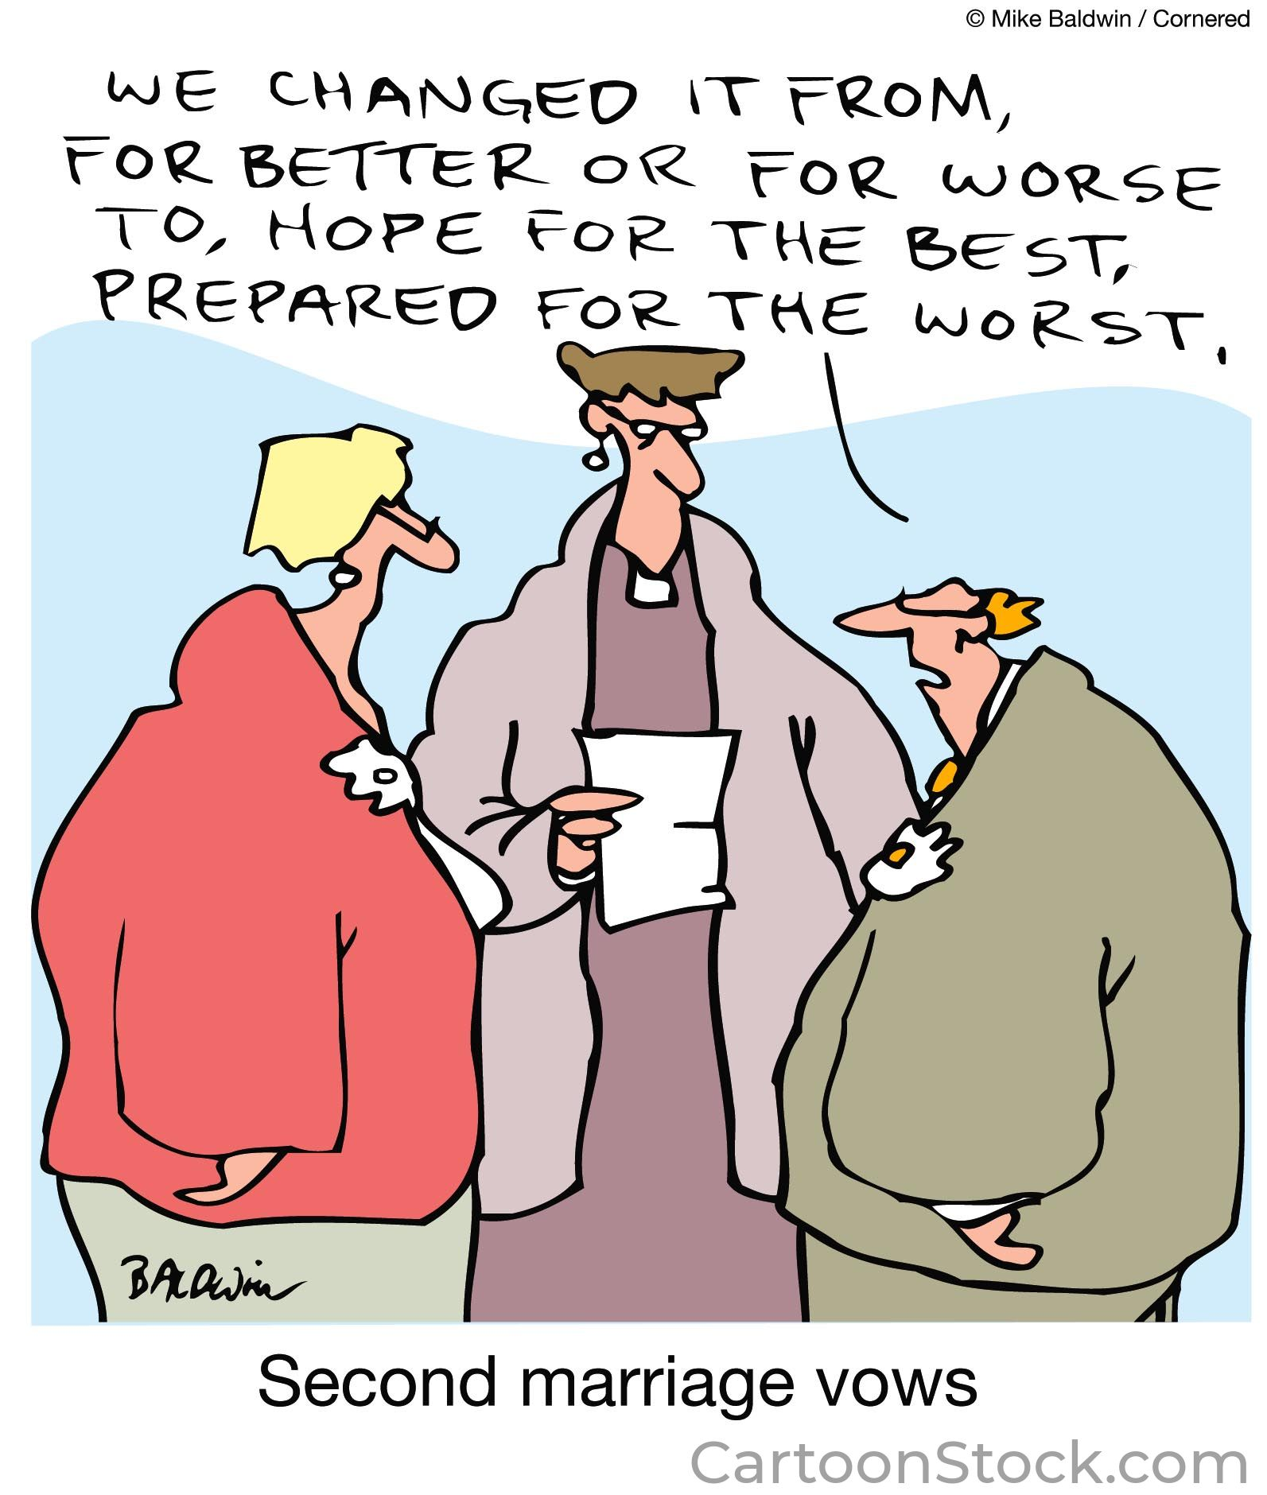
Build Your Future: Using the Collaborative Process to Negotiate Cohabitation Agreements / Marriage Contracts

Slide 2
IACP FORUM, TORONTO 2023
CORI KALINOWSKI, JD, BComm, AccFM, ACP
Family Lawyer & Mediator
CAROLINE FELSTINER, RSW, MSW, AccFM
Family Professional & Mediator
TERRI MCDOUGALL, PFP, CFDS-AA
Financial Professional

Slide 3
Poll:
Who has had the opportunity to use the Collaborative process for marriage contracts?
Who has used a full team for marriage contract negotiations?

Slide 4
3 Key Features of Successful Marriage Contracts and Cohabitation Agreements:
Agreement reflects the values and goals of both spouses and acknowledges the relationship they are building together
Provides a full and clear picture of their financial situation
Both parties understand and agree with the legal consequences of the agreement and are fully informed about the alternatives

Slide 5
Challenges of Negotiating Marriage Contracts from a Legal Perspective:
Can’t predict the future
Third parties who are more invested in the negotiation than the spouses who may be reluctant participants
Getting disclosure from third parties (extended family or business partners)
Manage power imbalance (disparate wealth), avoid duress
Lawyer may alienate their own client
May be a time crunch because of a pending wedding date
May turn into a Separation Agreement negotiation

Slide 6
Emotional/Relationship Challenges of Negotiating Marriage Contracts:
Negotiating a MC can be like opening Pandora’s box. The process may uncover intense feelings about the couple’s relationship, commitment, future goals, communication or problem-solving styles
There are often third parties working in the background of the negotiation, influencing, demanding or pressing for a particular outcome (e.g. parents of the couple, adult children from previous relationships, business partners). The couple must manage their own negotiation while taking third party relationships into account
The process may raise doubts about the relationship which must be explored and resolved before a final contract is in place
The relationship may end during the process, triggering unexpected changes, disappointments and grief

Slide 7
Financial Challenges of Negotiating a Marriage Contract:
Differing attitudes towards money – savers vs. spenders; pay debt or invest, budget or spend
Cost benefit analysis of valuing assets (e.g. valuations of real estate, trust interests, business interests)
Accuracy of financial information about wealth, value of assets, inheritances, trust structures,
How to plan for the future, examples of consequences of options under consideration
Financial experience and education, ensuring knowledge about own and other’s finances
Employment/careers and earning potential especially if younger couple
Estate planning, (children from previous marriages, insurance and trust needs)
Ways to provide financial security given terms of the contract

Slide 8
Collaborative Process Design: Dealing with the Challenges
Composition of Team
Tools to identify, understand and work through the challenges that come up in Marriage Contract negotiations
Goals and Concerns Questionnaire
Exploring underlying values
Mining for Interests
Speaking with interested 3rd parties @ expectations
Structure of meetings
How to share sensitive financial information
Identifying and accommodating different decision-making styles
Team to discuss and decide which tools can be used to ease/smooth negotiation process
Professional communications,

Slide 9
Core Values: Make a list of your 4 core values.
Integrity | Giving to Others
Time to Reflect, to be quiet | Family Vacations
Self Improvement, Lifelong learning | Loyalty/Faithfulness
Independence | Personal Image
Caring for the Environment | Spend to Enjoy life now
Social Standing | Recreational Pursuits (sports, hobbies)
Strong/Healthy Relationships | Healthy Lifestyle, Exercise
Religious Beliefs / Faith | Professional/Career Achievement
Culture (arts, music, travel) | Saving for the future, be frugal now
Fairness/Justice | Community Involvement
Academic Achievement | Financial Responsibility
Financial Independence | Self Improvement, Lifelong learning,
Friendship | Spiritual values
*The list of values for this exercise has taken from workbook called Designing our Future Together created by Janita Gallant and used with her permission. You can find out more about this workbook and Jacinta’s other offerings at https://jacintagallant.ca/InnovationForLawyers

Slide 10
Decision-making (Process) Values:
Dialogue (discuss and talk it over before deciding) | Hierarchy (I am the person in charge)
Collaboration (work together to meet all needs) | Delegation (leave it to others)
Exclusivity (only some participate in the decision) | Inclusivity (consult with all affected)
Equality (each person has an equal say) | Reflective Thinking (take time, explore possibilities)

Slide 11
Family case scenario:
We are going to introduce to you Erica and Andrea.
Imagine this is your new file.
Think about the process you would design to support this hopeful couple.
Consider what may challenge the negotiation process and contemplate how the CP process you design can meet those challenges.
Notes:
Andrea is a creative, artistic soul who values dialogue and close relationships. She is generous and sometimes impulsive. She values her independence and her ability to live life on her own terms, including travelling and exploring new cultures. . Her father, who is a successful business person, wants her to have a marriage contract that “protects” her investment in the house and her future.
Eric is hard working and likes to play hard when he has the time. He admires Andrea’s creativity and curiousity. He appreciates the stability that her family has. He very much cherishes his relationship with her parents and his own mother. Eric wants children and wants their life to be less stressful than his own upbringing.

Slide 12
Eric and Andrea are in their early 30’s and have lived together for 3 years
Eric is a hard-working entrepreneur & real estate developer. He pays himself an income of $200,000 with frequent additional draws.
Andrea is a creative soul who values dialogue and close relationships. She is an artist, selling a few sculptures a year earning $15,000/yr
Eric was raised by a single mother who struggled financially. Eric believes in ”handshake deals” and is uncomfortable with lawyers or legal documents. He cherishes his relationship with his mother and with Andrea’s parents. He appreciates the stability that her family has and wants to create the same financial security in his family with Andrea.
Andrea comes from a wealthy family. She is a beneficiary of a trust and owns a cottage with her two sisters. She values her independence and her ability to live life on her own terms including exploring new places and cultures.
They recently purchased a renovated house together worth $2 million with a $1.2 million mortgage; part of the mortgage was invested in Eric’s business; Eric paid for the home renovations, and Andrea contributed $500,000 towards the purchase using a gift from her parents. They are planning on starting a family; Andrea expects to be a stay-at-home mother.
Andrea’s parents are concerned that her future wealth be protected and preserved.
Eric and Andrea are getting married in 5 months.

Slide 13
Discussion
How would you design a collaborative process to help this family?
How would you ensure the process you build addresses the key features of a successful contract?

Slide 14
Summary of Collaborative Marriage Contract Negotiations
Retain Collaborative Lawyers
Interim or Standstill Agreement
Retainer Agreements & Joint Process Agreement
Team as Appropriate
Value Assets and Debts
Financial Disclosure
Negotiation Meeting(s)
Explain the law, types of marriage contracts,
Review Financial Information
Relationship/Emotional Work
Goals and Concerns/Values/Vision of future
Generate Options
Neutrals to Facilitate
Settlement Drafting
Joint drafting with questions and comments
Review with Clients/ Time to reflect
Tweak, Finalize and Sign

Slide 15
Questions and Comments

Slide 16
Exit Poll: How many would use the CP process on your next Marriage Contract/Cohabitation Agreement? Would you use a full team collaborative approach?

Slide 17
Thank you and enjoy the conference!
Cori Kalinowski, J.D.B.Comm.,AccFM,ACP
Lawyer and Mediator
clkalinowski@kalinowski-law-office.com
1(416)598-9495
Caroline Felstiner, MSW, AccFM
Family Professional and Mediator
caroline@felstiner.com
1(416)-723-6716
Terri McDougall, PFP, CFDS-AA
Chartered Financial Divorce Specialist – Advanced Accredited
terri@collaborativedivorcesolutions.ca
1(416)799-7861

