Slide 1
Befriending Paradox
Victoria Smith, JD
Nancy Cameron LLB

Slide 2
Brief introduction of the day
Overview of Adam Kahane’s Facilitating Breakthough
Exploration of how we facilitate settlement by cycling through vertical and horizontal processes
Deep dive into three common paradoxes *
Logic and emotion
Principle and compromise
Engaging and avoiding
* Applying concepts from Bernie Meyer’s The Conflict Paradox: Seven Dilemmas at the Core of Disputes.

Slide 3
Paradoxes
What are they?
As they arise in our work. What are our struggles or challenges?
What’s going on:
For us
For our clients
How do we move away from either or thinking?

Slide 4
It’s ok to be strategic!
Strategies for toggling between vertical and horizontal facilitation
Strategies to work with particular paradoxes so we don’t get stuck in the binary.

Slide 6
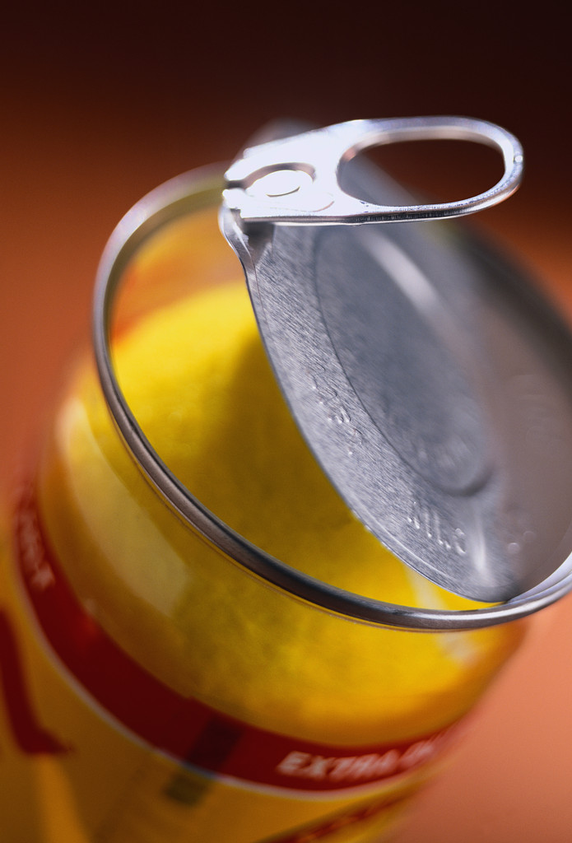
When You Flip Your Lid
STOP
Notes:
Remember Siegel’s hand? Pre-frontal cortex is no longer linked
Stop
Breathe
Openness, observation and objectivity (reflection)
Reconnect with ourselves
Reconnect with others
If we try to reconnect without reflection (observation and objectivity) then we revisit what happened and evoke the same reactive flow
Collaborative practice invites us to become REFELCTIVE PRACTITIONERS
Reflection is a compassionate state of mind

Slide 7
Sometimes it’s hard for us to remember
Collaboration is not the first option.
If people have a choice, tend to choose
Force
Adapt, or
Exit

Slide 8
Can we change the situation?
yes
no
Can we effect this change unilaterally?
Can we bear this
situation as it is?
no
yes
yes
no
Collaborate Force Adapt Exit
Multilateral unilateral unilateral unilateral

Slide 9
Do we have the conditions necessary for Collaboration?
If the conditions for Collaboration exist, then this provides momentum
If the conditions for Collaboration don’t exist, then the facilitator may need to provide the momentum
Does embedding in one end of a paradox (ex. avoid, emotion or logic, principal or compromise) become a way to try to force or exit or adapt?

Slide 10
How do we see our Situation?
Vertical Facilitation
Horizontal Facilitation
We have the right answer
Upside: Expertise and decisiveness
Downside: Groupthink and repudiation
To shift towards horizontal INQUIRE
We each have our own answer
Upside: diversity and inclusion
Downside: Cacophony and indecision
To shift towards vertical ADVOCATE
Notes:
Vertical – part of the leadership we bring – you need to address these issues. We need to be careful – we don’t need to address child support or we don’t need a parenting plan and the lawyers may say you have to. Even the things that we see as obvious to be resolved may not be the necessary pieces; be careful we don’t impose on the vertical TOO much unnecessarily.

Slide 11
How do we define success?
Vertical Facilitation
Horizontal Facilitation
We need to agree
Upside: Finish line
Downside: Impasse or poor agreement
To shift towards horizontal - ADVANCE HOW.
We each need to keep moving AND stay in relationship
Upside: Pragmatic
Downside: Dispersion, process fatigue
To shift towards vertical - CONCLUDE HOW.

Slide 12
How do we get from here to there?
Vertical Facilitation
Horizontal Facilitation
We know the way
Upside: A clear route
Downside: Dead end and over a cliff
To shift towards horizontal: BE CURIOUS, DISCOVERY, ITERATIVE STEPS
We will find our way as we go
Upside: Flexibility
Downside: Divergence and disorganization
To shift towards vertical: MAP, AGENDA

Slide 13
How do we decide who does what?
Vertical Facilitation
Horizontal facilitation
The professionals decide
Upside: Authority and alignment
Downside: Subordination, insubordination (non-compliance)
To shift towards the horizontal - ACCOMPANY (SUPPORT FROM BEHIND)
We decide for ourselves
Upside: Self-motivated action
Downside: Separateness, misalignment
To shift towards the vertical - DIRECT

Slide 14
A chance to work with vertical and horizontal facilitation
Exercise #1

Slide 15
Debrief Exercise #1
Plan #1 The horizontal plan:
1
Upsides:
Downsides:
If it doesn’t work, how and when would you toggle to vertical?
2
Plan #2 the vertical plan
3
Upsides:
Downsides:
If it doesn’t work, how and when would you toggle to horizontal?
4

Slide 16
Principle and Compromise

Slide 17
It’s the Principle!
Those that have difficulty with compromise tend to be highly principled
Can we spot this early in our clients?
Underneath each principle is another principle - the deeper we go, the less willing we are to compromise.
The most important source of power we have is our conviction and clarity about our values
and
Rigid adherence to principle can diminish our power

Slide 18
Short exercise in pairs
Think of a principle you hold dear. Reduce it to one sentence. Write it down.
Some examples
I support the death penalty.
I don’t support the death penalty.
People should not have the right to vote if they are in jail.
Everyone should have the right to vote, being in jail should not dis-enfranchise you.
In pairs, see what you can discover about underlying values.
Switch

Slide 19
Debrief
What do you do with the values you have uncovered?
01
Is there one value that is non-negotiable?
02
Are there some compromises that still allow the person to hang onto the most important value?
03
Compromise fatigue
04

Slide 20
Engaging and Avoiding
Not binary
Avoiding something creates space to engage in something else.
One person’s engagement may push other into avoidance.
Refusal to engage may push the other to try to force or exit.
Decisions about what to engage with and what to avoid are personal.
We can engage and avoid passively or actively.
Horizontal work to find out our client’s priorities.
Notes:
Personal choice. Need to unearth these pieces in a horizontal conversation. What looks like engagement may need to be away of avoiding and vice versa. Even process discussion is about engagement or avoidant.
Decisions about what to engage with and what to avoid are personal.
Importance of ongoing relationship
Past history
Is there a way to engage effectively?
We can engage and avoid passively or actively.

Slide 21
Short Exercise: Engaging and Avoiding
Think about a personal conflict you have had that you chose to engage in or not to engage in.
In hindsight, would you make a different choice or approach it differently?
Why or why not?

Slide 22
The DNA of Conflict
Emotion / Logic

Slide 23
PARK BENCH EXERCISE
Notes:
From P. 43 of Rightous Mind.

Slide 24
THE DNA BRAID: THE INTERPLAY OF EMOTION AND LOGIC
Not about gender or personality type
Without emotion, we can’t engage and make decisions
Yet we can’t resolve conflicts simply by expressing emotion
While we may focus on expression or analysis, both operate every step of the way and are essential to the other
Identity, meaning , values and security must be addressed for lasting agreements
Notes:
Tend to view emotions and logic as opposites
Also tend to stereotype-people are emotional or rational based on gender or personality type
Yet people act on intuition, instinct and emotion in conflict
We decide based on emotion and justify based on logic
Now recognize everybody’s both-it’s a question of whether and how emotions and ideas are expressed, what triggers lead to emotional responses, whether people tend to talk about their feelings or talk about what they should do,
People need to think about their feelings and experience emotional reactions to the ideas on the table-use the range of cognitive processes-emotional and logical-all the way
Any lasting agreement needs to address Emotional needs-identity meaning value security-what matters most
Brain science helps us understand how emotions impact thinking and decision-making

Slide 25
THE NEUROSCIENCE OF THINKING AND FEELING
It’s about approach (reward) and avoid (threat)
Prefontal cortex
Limbic-amygdala
Brain stem
Notes:
Actions either activate the primary reward or primary threat circuitry of the brain
THREAT: When experience threat, overall executive functions of prefrontal cortex decrease. Threat = diminished cognitive resources. The amygdala is activated, we err on the safe side, shrink from opportunities. Fear channels resources away from reasonable thinking toward the amygdala which process emotions. The amygdala goes into overdrive in response to threat, activating fight or flight that floods the body with adrenaline and cortisol. Reason is suspended. Fear paralyzes and creates inaction
People who feel directly threatened /attacked are less likely to solve problems.
APPROACH = engagement. State of willing to do difficult things, take risks, think deeply about issues and develop new solutions. Increased dopamine levels. People experiencing positive emotions perceive more options when trying to solve problems.
People who feel safe/appreciated/valued-more likely to engage other perspectives, explore ideas.
Particularly challenging in divorce

Slide 26
Fear and Anger (Lerner research)
Evoking anger :
can increase feelings of certainty and control
can lead to becoming more punitive, even if the situation causing the anger is unrelated to what they are judging
Evoking fear:
can enhance feelings of uncertainty and loss of control
increases stress hormones (cortisoid levels) which remain elevated for an extended period of time
Notes:
Meghan and Stephan (strategies)

Slide 27
OUR GREATEST CHALLENGE: HOW TO UNDERSTAND AND WORK WITH EMOTIONS IN DEAL-MAKING?
More than venting.
Create the space to experience emotional reactions to ideas and think about feelings.
At the same time, keeping emotions in perspective.
Working on both levels at the same time.
Notes:
Finding solutions to difficult problems-not the hardest part of our work
Why do people often reject perfectly good deals that appear to satisfy expressed interests?
The most difficult thing we do is to understand and work with the emotional element [the need for acknowledgment and appreciation, a breach of values and sense of fairness, concerns about identity] AND help people work constructively with their emotions to make good choices
We need to offer space to receive emotion and the intangible needs and values
let people experience emotional reactions to ideas. Attempt to acknowledge and understand before we jump in
Need to examine our own comfort level with emotion-do we shut it down / separate the parties too soon? Why?

Slide 28
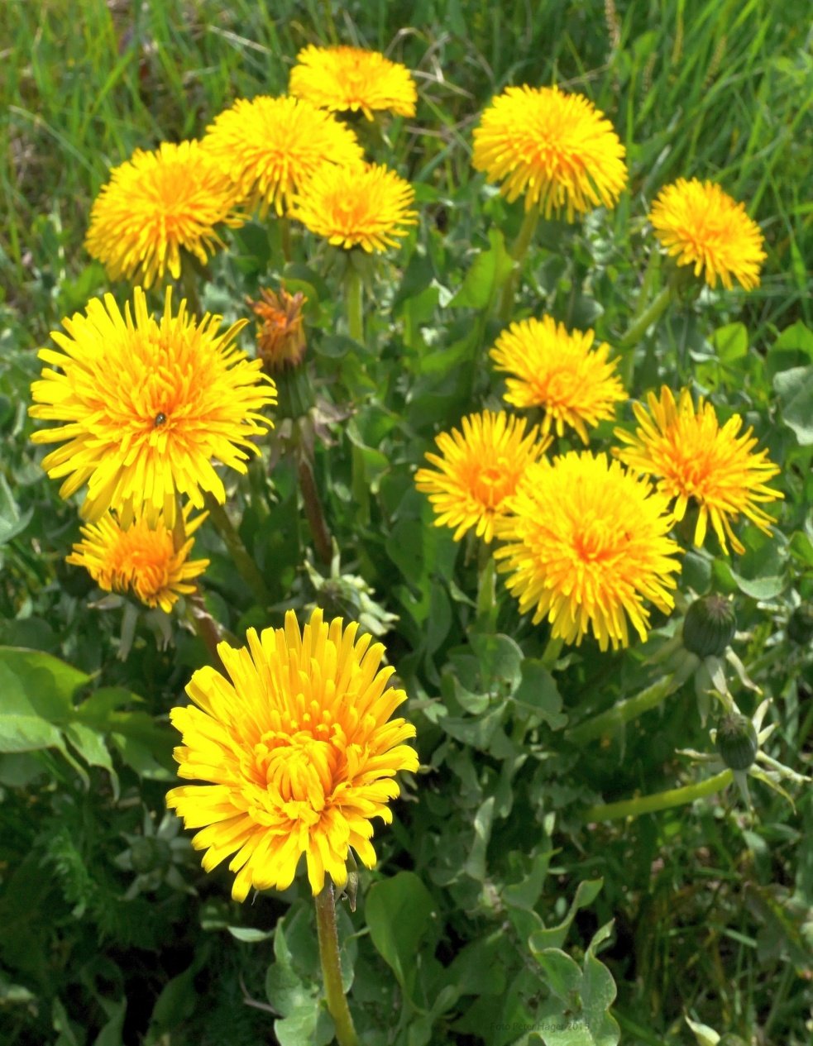
We react to stress differently
Dr. Thomas Boyce: The Orchid and the Dandelion: Why Some Children Struggle and all can Thrive
Notes:
Trauma and stress can rewire our brains

Slide 29
Techniques to support emotional regulation and reduce stress
Heighten predictability
Increase sense of individual control
Name it to tame it
Sit on my hands
Create the physical environment
Tap one foot and then the other
Scent
Notes:
Name it to tame it engages both right and left hemispheres; experiment where people watched an accident
Do an accusation audit

Slide 30
Strategies to manage emotion and logic
Observe what’s going on
Counterbalance tendencies toward feeling or thinking
Allow venting safely and effectively
Be aware of our own tendency and share it
Notes:
Observe-name that one client is speaking about how they feel in the other is talking about what to do now. Looks like you're talking past each other a bit
Identify feelings and thinking-ask the logical client about their feelings OR to say more about the reasoning and how they developed it
Sometimes people need to vent-express how they feel for they can move on. Challenge to make sure isn't a way of avoiding conflict and shutting down the other person, keeping everyone safe, not reinforcing an abuse of power dynamic
Notice that I may want to calm things down and stay rational but that might not be what's needed at the moment or something like this nice rational conversation is but I'm wondering if were avoiding the real feelings here
Strategies to manage emotion and logic

Slide 31
A Chance to Work with Engaging and Avoiding (with emotion!)
Exercise #2

Slide 32
Debrief of Exercise #2
Conflict style of each person during the marriage- when did they engage/avoid? What happened ? What does each want to do now?
What are each person’s most important goals wants and worries? Are any internally competing?
Thinking about avoiding and engaging, how will you help each person prepare to express her goals and worries at the first meeting and hear /respond to the other?

Slide 33
A Chance to Work with Principle and Compromise (with emotion!)
Exercise #3

Slide 34
Debrief of Exercise #3
Vivian
Principle, underlying values, strategies
Working with emotion
What if she can’t compromise?
Emotional regulation strategies
Jasmine
Principle, underlying values, strategies
Working with emotion
What if she can’t compromise?
Emotional regulation strategies
Vertical - Horizontal

Slide 35
