Slide 1
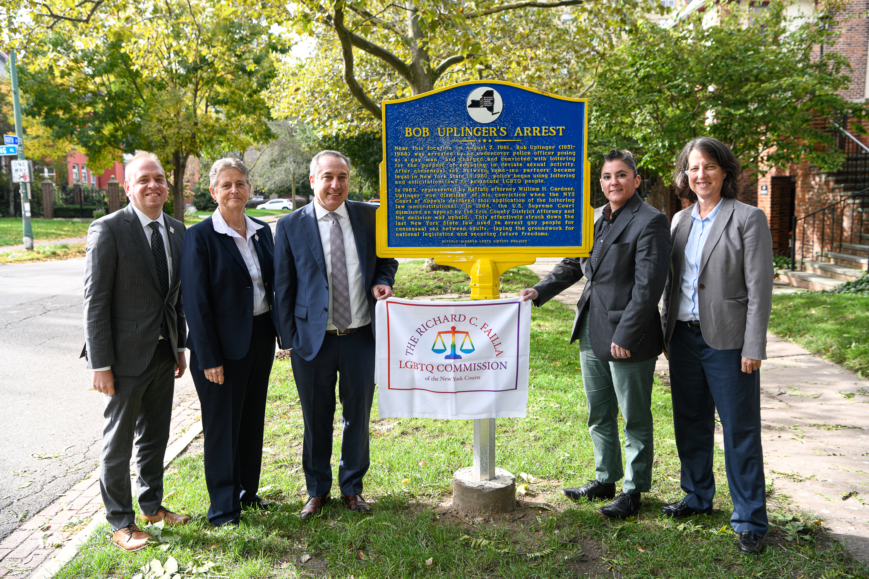
Working with LGBTQ People in the Law
New York State Council on Divorce Mediation
Charlie Arrowood, Esq., Senior Counsel, Failla Commission
April 2023

Slide 2
The Failla Commission
Established by former Chief Judge Janet DiFiore and former Chief Administrative Judge Lawrence Marks 12/2016
2 Co-Chairs and 20+ Commissioners from around the state
Mostly judges but also several private practice attorneys and other advocates, Executive Director, Senior Counsel
Dedicated to promoting equal participation and access throughout the court system by all persons regardless of sexual orientation, gender identity, or gender expression
Policy advocacy and educational programs focused on cultural competency and legal developments for judges, non-judicial personnel, and court partners
https://www.nycourts.gov/ip/LGBTQ/index.shtml
Follow us on Twitter @NYCourtsLGBTQ

Slide 3
Why do LGBTQ Diversity & Inclusion Best Practices Matter?
Procedural fairness and public confidence in the legal system
Opportunities for voice
Transparency in action
Impartiality in decision making
Fairness in processes

Slide 4
Basic Concepts & Terminology
Birth Sex: A person’s sex assigned at birth, usually male or female
Gender identity: A person’s deeply held internal sense of their own gender (i.e., being male, female, or somewhere else on the gender spectrum)
Gender expression: How a person chooses to communicate their gender identity to others through clothing, hairstyles, mannerisms, social interactions, etc.
Sexual orientation: Describes an individual’s emotional, physical, and/or romantic attraction to other people
Gender dysphoria: Discomfort stemming from the disconnect between a person’s physical body/sex assigned at birth and their internal sense of their own gender/how their body should look (F64 in the DSM)
Everyone has each of these
Transgender is not a sexual orientation
Trans people can be any sexual orientation

Slide 5
Basic Concepts & Terminology
Transgender person
Someone who knows that their gender identity is significantly different from their sex assigned at birth
Cisgender person
Someone who knows that their gender identity does not significantly differ from their sex assigned at birth – someone who is not transgender
Nonbinary person
Someone who, regardless of their sex assigned at birth, does not feel squarely male or female
Intersex
An umbrella term for unique variations in reproductive or sex anatomy. Variations may appear in a person’s chromosomes, genitals, or internal organs like testes or ovaries. Some intersex traits are identified at birth, while others may not be discovered until puberty or later in life.* Intersex is not a gender; some intersex people identify as trans or nonbinary while others identify as cisgender.
*Intersex Definitions - interACT: Advocates for Intersex Youth (interactadvocates.org)

Slide 6
The Galaxy
Sex: male, female, intersex
Gender identity: male, female, nonbinary, etc.
Gender expression: masculine, feminine, androgynous, etc.
Sexual orientation: lesbian, gay, bi, pan, queer, straight, etc.
Everyone, including cisgender heterosexual people, is some combination of these things and can fall anywhere in the SOGI galaxy

Slide 7
Pronouns
She/her/hers
He/him/his
They/them/theirs (gender neutral)
Neopronouns
Ze/Hir and Ze/Zir Pronouns — Pronouns.org Resources on Personal Pronouns
Pronouns.org Resources on Personal Pronouns
Best practices
Ask all individuals – not just trans people! – what pronouns they use
Use the correct pronouns consistently
Introduce yourself with your own pronouns
New York State Advisory Committee on Judicial Ethics Opinion 21-09 (2021)
NYSBA NY Rules of Professional Conduct (2021) (nycourts.gov) (Rule 8.4(g))

Slide 8
Terms to Use
Transgender person or transgender people
Transgender is an adjective, so you would not say “a transgender” or “transgendered”
Often shortened to “trans”
Transgender woman
A woman who was assigned male at birth
Transgender man
A man who was assigned female at birth
Gender transition (e.g., “they transitioned”)
Not “transed”
Nonbinary/genderqueer/gender nonconforming person
Whatever terms people ask you to use

Slide 9
Transition
Social
Clothing
Activities
Using different name/pronouns
Medical
Hormones/blockers
Surgical intervention
Legal
Court-ordered or administrative name change
Gender marker change
Updating official documents
There are as many ways to be trans as there are trans people. Not everyone undergoes any/all of the above, whether because it’s not right for them or not accessible to them.
Want/need different things to feel affirmed
May not have access to gender affirming clothing, health care, document changes
Financial or safety reasons, any other reason
Lack of access can contribute to everyday risk

Slide 11
LGBTQ People Exist
Assume LGBTQ people exist generally and plan for that, but do not make assumptions that any particular person is/is not LGBTQ
You cannot know a person’s gender identity, sexual orientation, or family relationships based on their voice, personal appearance, manner, name, IDs/records, etc.
Prepare for ID documents that may not match the name the person uses
Include pronouns/honorifics in intros, bios, email signatures, Zoom names, etc.
Ensure health insurance coverage includes trans care and that covered reproductive care is LGBTQ-inclusive [may be relevant if determining which whose insurance should cover a child or parent]
Have a collaborative Transition Policy
What happens when an employee or party/client transitions?
Bathrooms
Updating names/pronouns
Informing parties and colleagues
Corrections
Will differ for everyone so leave room for conversation with the person
Include preferred name, pronoun, and honorific fields on check-in forms and relay that information internally so it is used

Slide 12
Honor Everyone’s Authentic Self
What name do you usually go by?
How would you like to be addressed? For example, I use [pronouns].
Only ask about/use legal name when required
Establish the record with footnotes but use chosen name otherwise
Always mirror the person’s word choices even if you don’t understand what they mean
If you make a mistake, acknowledge it, thank the person for correcting you, and move on
Confirm whether the person would like you to correct others
Call-out vs. call-in
Could be a safety risk if they’re not out to everyone
Maybe they don’t want to draw attention or create conflict
Honorifics:
Mr., Ms., Mrs., Dr., Mx. (pronounced “mix”)
Not everyone uses honorifics
Make them optional on forms and in systems
Reconsider using them in correspondence
If concerned about formality and want to avoid using first names, something like, “Good afternoon, counselor,” is neutral and professional
Provide non-M/F gender options where applicable (X, neutral, write-in)

Slide 13
Be Respectful
Rein in personal curiosity – it is NEVER okay to ask invasive or personal questions about a person’s identity, body, or transition experience
How would you feel if someone asked you the same questions?
If such information is absolutely necessary to know…
Always provide context for your questions
Limit scope of questions
Always ask respectfully and acknowledge when you don’t know how
Confirm what language the person would like you to use
Anyone can have a preference about how to talk about their identity, body parts, relationships, etc.
This information belongs to the person it is about; be conscious about how you share it
Be conscious of the variety of barriers LGBTQ people face in housing, employment, involvement in the criminal legal system, etc.

Slide 14
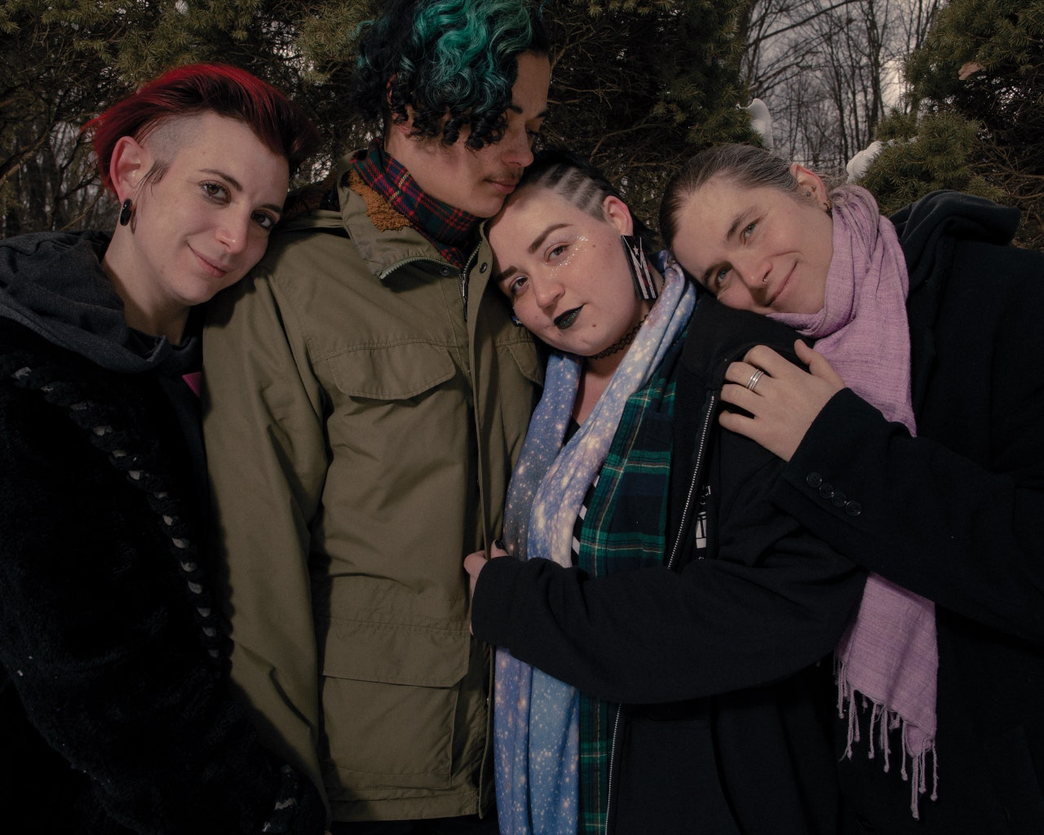
Combat Heterosexism
Honor everyone’s relationship status even if it is outside of traditional married/divorced/widowed/single paradigm
Are you in a committed relationship?
Do you have one or more partners or significant others?
Keep language neutral until the person indicates the appropriate language, then mirror
Remember:
LGBTQ people may have children, too
Just because a person has historically been with someone of one gender does not necessarily mean everyone they are with will be of that gender
Be mindful about your language when referring to a person’s relationship to their children, whether biological, adoptive, by marriage, legal guardian, or not otherwise formalized
Photo credit: The New Yorker

Slide 16
SOGI Issues in Mat/Family Law Cases
Transgender people have a higher risk of mental health comorbidities like depression, anxiety, and suicidality not because of their trans status but as a result of the way society views and treats trans people
Transitioning parent
Trans identity itself and the fact of transition are independent of someone’s ability to parent and should not themselves be determinative in custody/visitation determinations
Transitioning child
All major medical associations agree that the appropriate treatment for gender dysphoria – including for minors – is transition, to whatever extent the trans person feels that is necessary
Research shows having just one supportive adult in a trans child’s life significantly reduces (by 40%) mental health comorbidities including anxiety, depression, and suicidality
It is detrimental to a child’s health and wellbeing, and therefore not in the child’s best interests, to be with a parent who does not respect their gender identity, whether that manifests as a refusal to use chosen name/pronouns, withholding of medical treatment, general disrespect and abusive language, or anything else
If parents disagree about a child’s transition, it is in the child’s best interest for the supportive parent to make medical decisions regarding transition
At the appropriate age, hormone blockers provide a pause button
Puberty is not reversible and forcing a child to go through the wrong puberty is not passive
Blockers buy everyone time to go to therapy and determine the appropriate course of action without forcing a child to permanently develop in a way that harms them and either can’t be reversed in the future or requires surgical or other medical intervention that could be avoided or mitigated
May become more common as families flee states with new laws curtailing access to transition-related healthcare (S8842-A Safe Harbor proposal)

Slide 17
Questions or Concerns?
E-mail
carrowoo@nycourts.gov

