Slide 1
The Heart of Conflict: Giving Voice to Non-Material Needs
IACP Forum 2019
October 24, 2019
Nancy Cameron, Q.C.
Stephen H. Sulmeyer, J.D., Ph.D.

Slide 2
Negotiating Approaches
Power based: recognizes that those with power may be able to force the result they want.
Rights based: recognizes mutual constraint by the rule of law.
Interest-based: recognizes the value of considering interests underlying positions.
Post-Interest-based: recognition of value of relationships, feelings and needs of disputing parties, as well as interests.

Slide 3
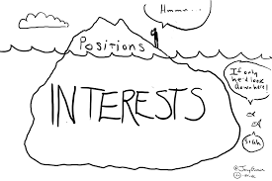
Interest-Based Negotiation
The current gold standard in the collaborative world is interest-based negotiation.
One problem with interest-based negotiation is that it tends to define interests solely as material interests.

Slide 4
Positions, Interests, Values and Non-Material Needs
Position
↕
Interest
↕
Value
↕
Non-Material Need

Slide 5
Why do Non-Material Needs Matter?
The failure to meaningfully address the parties’ non-material needs is one of the primary causes of conflict and impasse.
Declared aims are not always the real aims, and some motivations are probably not consciously recognized.
People must have their non-material needs met, and will often fight or even die in order to have these needs met.
People are more likely to resist reaching an agreement if they perceive that the process is not supportive of their getting their non-material needs met.
Solutions that address the basic needs of both parties are likely to be more satisfactory and more durable.

Slide 6
Material Versus Non-Material Needs
Material needs are often zero-sum (e.g., a finite amount of money each month).
Non-material needs are not zero-sum. There is no shortage of understanding and care.
Beware of conflating material and non-material needs. Leads to impasse. “There is no legal solution to an emotional problem.”
Mutual exploration of non-material needs meets them, and creates human connection. From a place of undefended connectedness people are better able to negotiate the distribution of scarce resources.

Slide 7
What Are Non-Material Needs? How do They Manifest?
“I need to be able to make my own decisions.”
“I need to live my life!”
“I need to know I’m not going to be a bag lady.”
“I don’t want to go too long without seeing my children.”
Underneath both material and nonmaterial interests are what might be called “core needs.”

Slide 8
Non-Material Needs
Safety. A sense of security, of relaxed ease, and freedom from physical and emotional harm.
Nurturance. The need for touch; to feel cared for, protected, supported, guided. Mature interdependence.
Autonomy. A sense of agency, of efficacy, of capacity, of power, of freedom, of empowerment, of finding and using one’s voice, of choosing one’s dreams and goals and the means of fulfilling them.
Acknowledgement/Recognition.
Respect.

Slide 9
Non-Material Needs
Connectedness/Acceptance. A need for intimacy, closeness, relatedness, of belonging; a need for affiliation; a need to be seen and known and loved for who we are by another. Includes the need to protect and nurture those we love.
Self-esteem. A sense of self-worth, self-value, respect, dignity, accomplishment, both from oneself and from others.
Meaning. A sense that what we do in the world is worthwhile, fulfilling, and matters. A sense of contentment, fulfillment and authenticity. A sense of integrity, of living from and as our highest or authentic self. Includes people’s creative and spiritual yearnings.

Slide 10
Non-Material Needs
Fairness & Justice. A sense that one has the same opportunities as others, that one isn’t fettered with unmerited restraints on advancement, a sense that one is being treated equally with others.
Social/Societal Fulfillment. Our need for family and community. Includes the need to live in and help create a society and world that is informed by our highest ideals, such as love, compassion, justice, and inclusiveness.
Play & Celebration. Includes our need for fun and laughter, as well as our need to celebrate life’s beauty and magnificence, including its losses.

Slide 11
Choose Your Own Adventure!
Think about a conflict you have had. Was there a time when a non-material need was not being met? What could have happened that would have met this need?
OR
Think about a conflict you had in which a non-material need WAS met. How was this done? How did you feel? What happened to the conflict?
Pair and share

Slide 12
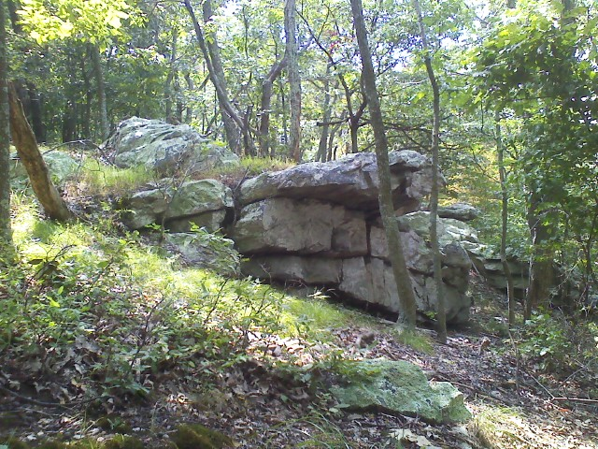
Emotional Outcroppings
Emotional outcroppings are indicia of un-surfaced emotional issues, including non-material needs.
E.g., body language
Change in tone or volume of voice
Change in facial expression
Looking away (or other “edge behavior”)
Tightening up
Shutting down
Tearing up
The dog that didn’t bark
We need to continually scan for emotional outcroppings, and follow up when and as appropriate.

Slide 13
Articulating Non-Material Needs
To ensure that you’ve got below the expression of positions or interests to a non-material need, ask: “If you got that, then where would you be?” Or, “If you got that, what would that give you?”
Another way is to ask, “If you got that, what would that feel like?” Or, “If you got that, then who would you be?”
Try this: imagine having one of the non-material needs completely met. Bask in it, feel into it. How does that make you feel?
Scanning for feelings:
When imagining having attained a non-material need, you feel fully and truly yourself: full, strong, whole, capable, your true and authentic self.
If a non-material need is not met, there may be feelings of emptiness, anxiety, loneliness, sadness or anger.

Slide 14
Working With Emotional Outcroppings
Where there’s smoke, there’s fire. Find the fire, don’t be distracted by the smoke.
The “emotional truth of the case” is the fire.
Ask: what is really driving this aspect of the conflict?
Inquire about the meaning of parties’ words, actions and positions.

Slide 15
Developing Negative Capacity
Moving into unfamiliar areas and dealing with new skills confronts us with many challenges. E.g.,
Fear of not-knowing.
Fear of making mistakes.
Fear of being vulnerable.
Fear of our own negative self-judgments and those of others.
What is needed for us to feel safe and confident enough to move out of our habitual comfort zone?
Negative Capacity: the capability to tolerate internal discomfort without suppressing or acting out.
There are many ways to develop negative capacity.
Mindfulness training is probably the most effective.

Slide 18
Sam and Cameron
You are a professional working with either Sam or Cameron.
Your task – help your client identify at least one non-material need.

Slide 19
Team Meeting
A team meeting of the professionals has been called. Agenda: How will we choreograph the next meeting to facilitate the non-material needs conversation between Sam and Cameron?
Be specific: Who will be at the meeting? Why these professionals? How will you prepare the clients? What do you hope to achieve?

Slide 20
Preparing With Sam or Cameron
Have a pre-meeting with your client (Sam or Cameron) to prepare for the four way (or five way or six way)
You can prepare with 1 or 2 professionals and the client.
Others observe.
Feedback

Slide 21
The Big Meeting
You’ve discovered your client’s non-material needs.
The professionals have had a team meeting and prepared for the “Big Meeting”
You have gone back and prepared with your client.
Time for the meeting – this can be a four way, five way, or 6 way meeting.
Large group debrief.

Slide 22
Process Design
How do we design processes to build dignity by meeting non-material needs?
The process should be specifically designed to enable the parties to identify and understand each other’s needs and to take the two sets of needs simultaneously into account as they work on the shape of an overall solution.
“Participants are encouraged to talk to each other . . . and to listen to each other – not in order to discover the weaknesses in the other’s argument, but in order to penetrate the other’s perceptive.” -- Herbert C. Kelman

Slide 23
Process Design
Process for Collaborative Professional Teams
Process for Mediations
Process for Practice Groups
What if someone’s non-material needs can’t be met? How do we design process for that?
How do we design a process that can help the parties move on to a more functional co-parenting relationship?
And…

Slide 24
Taking it Home

